Slide 1

Drivers of plant nutrient acquisition and allocation strategies and their influence on plant responses to environmental change
Evan A. Perkowski
Dissertation Defense
March 07, 2023, 1pm CT ESB1 Room 120
Zoom link:
https://texastech.zoom.us/j/93966902565?pwd=YVZEc0F6dytNY3B1SlNjM1lDVW1VUT09

Slide 2
General Introduction

Slide 3
Adapted from Fig 5.12 in IPCC (2021)

Slide 4
Photosynthesis = largest carbon flux between the atmosphere and land surface
Adapted from Fig 5.12 in IPCC (2021)

Slide 5
Photosynthesis = largest carbon flux between the atmosphere and land surface
Terrestrial biosphere models (TBMs) must accurately simulate photosynthetic processes to predict ecosystem responses to environmental change
Adapted from Fig 5.12 in IPCC (2021)

Slide 6
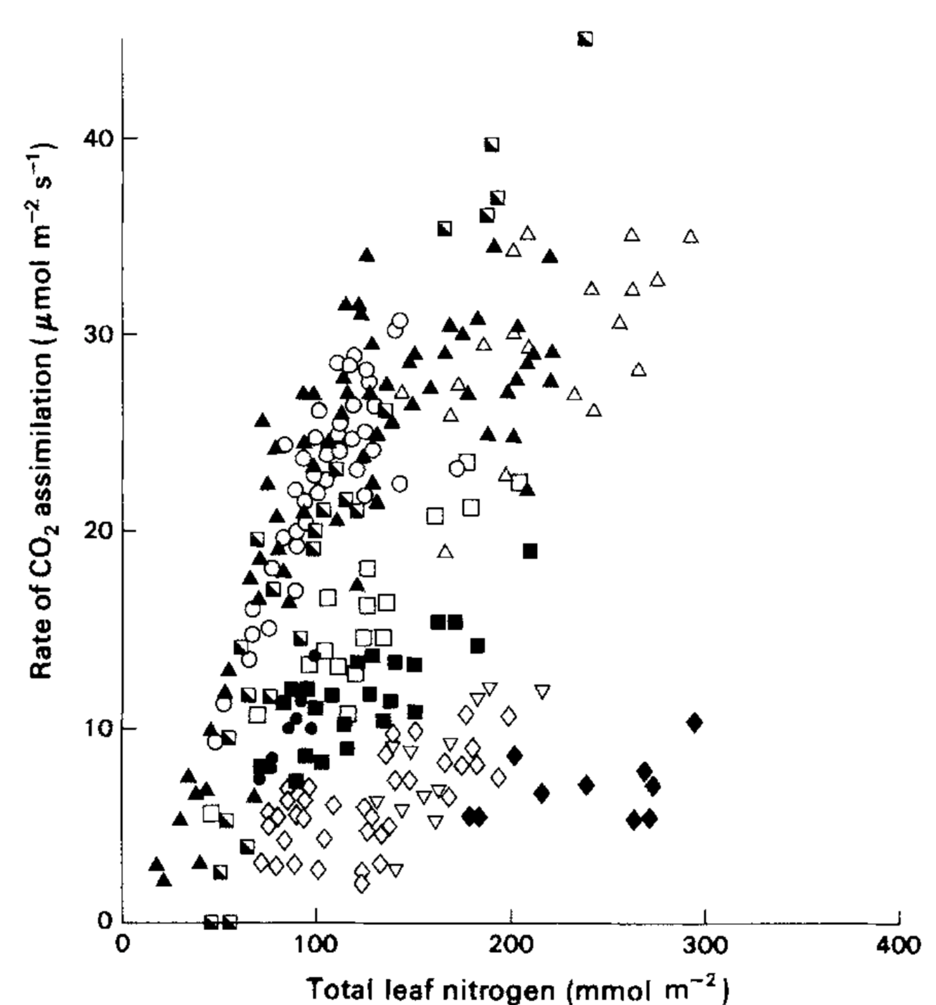
TBMs simulate photosynthesis through linear relationships between leaf nitrogen content and photosynthetic capacity…
Evans (1989) Oecologia

Slide 7
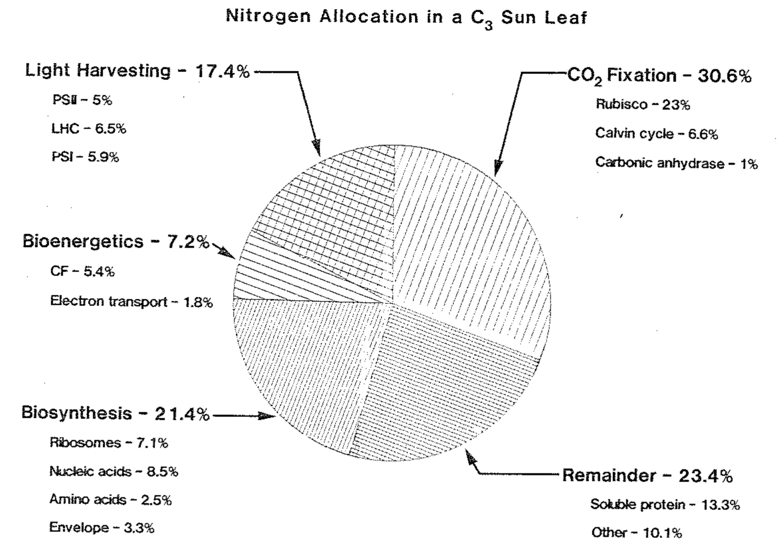
… following that high fractions of leaf nitrogen content are allocated to photosynthetic tissues
Evans (1989) Oecologia
Evans & Seemann (1989) Photosynthesis

Slide 8
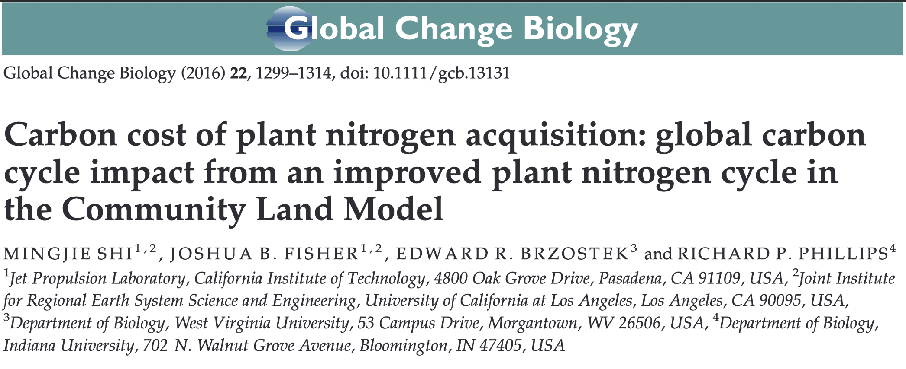
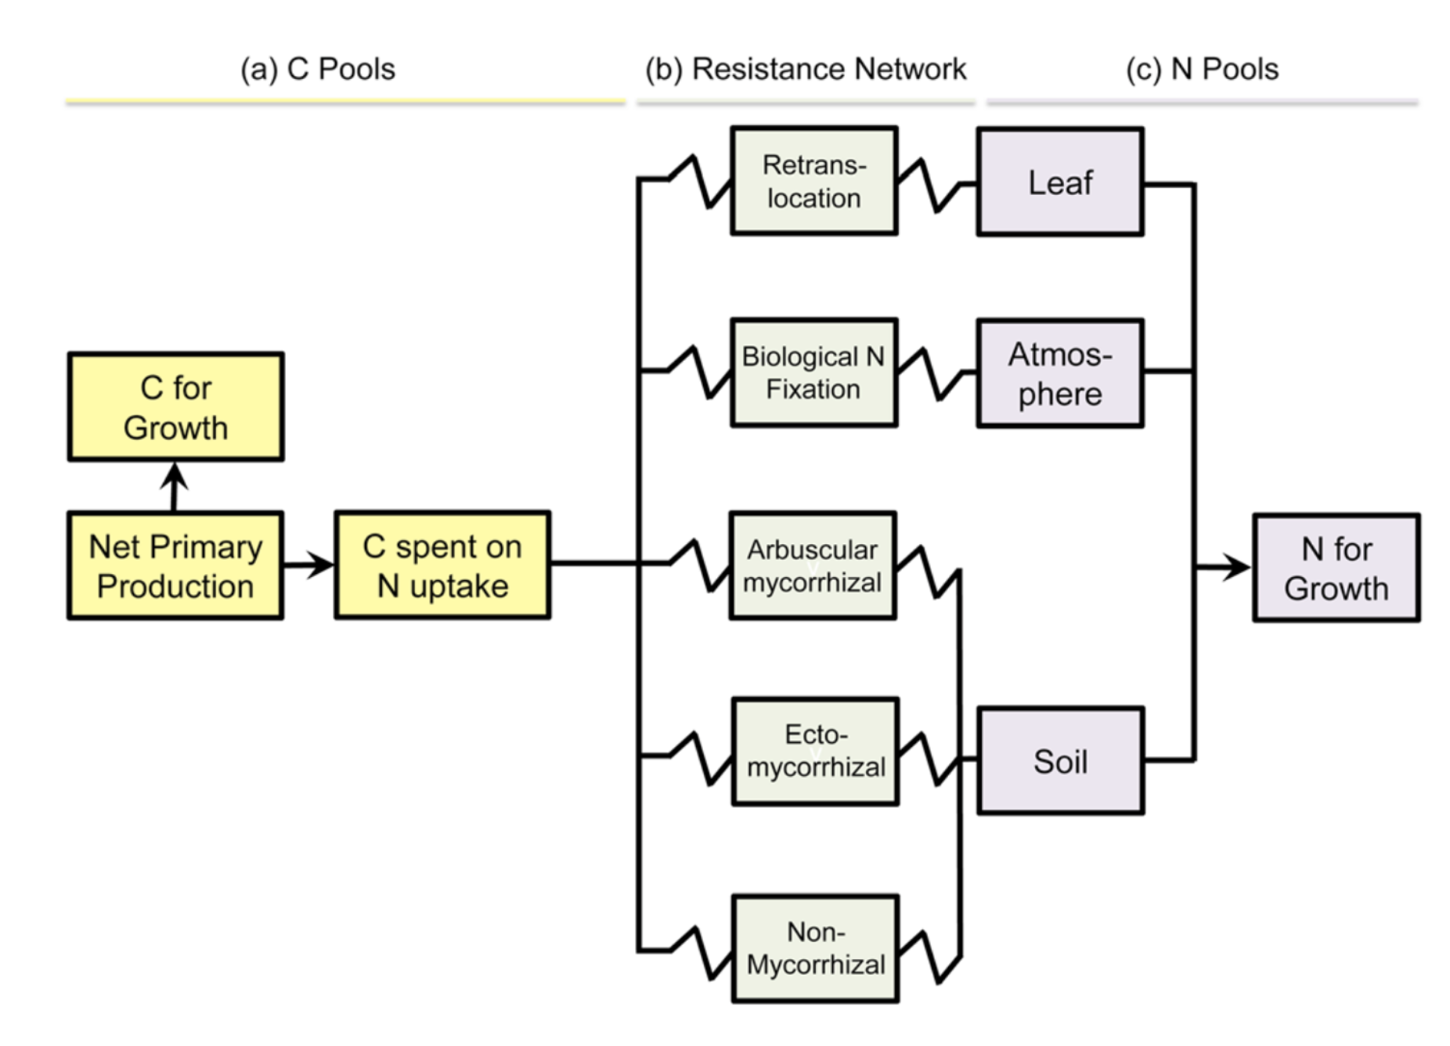
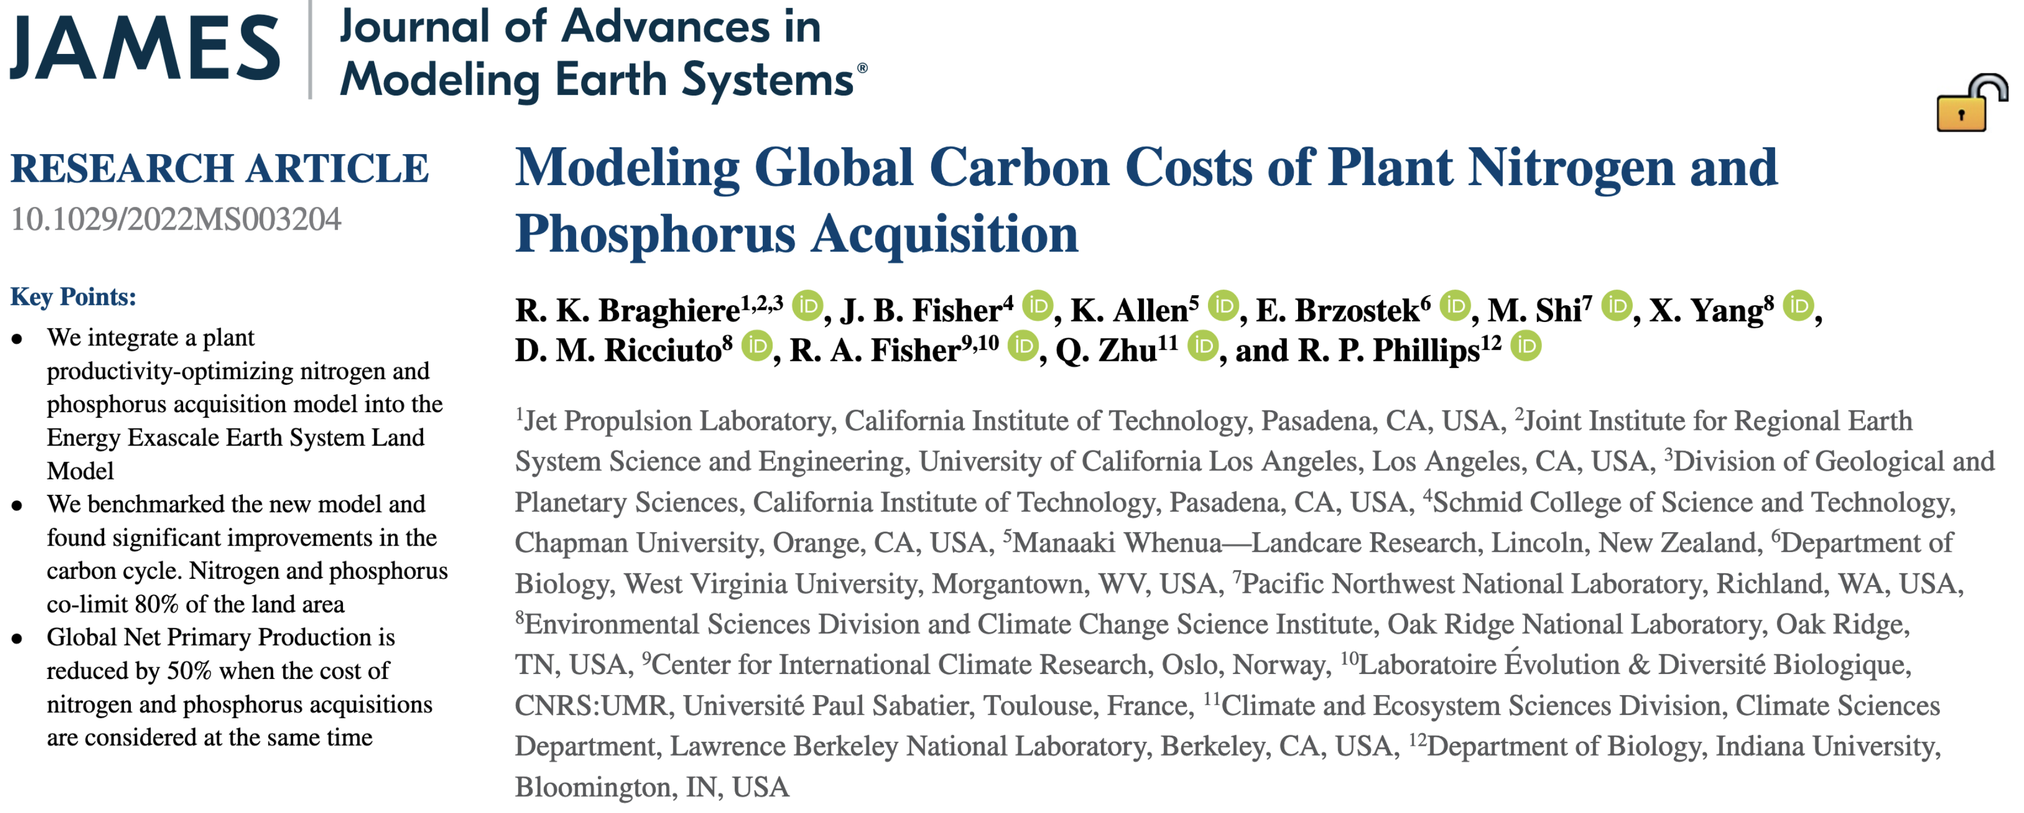
TBMs are beginning to incorporate coupled carbon and nitrogen cycles
Brzostek et al. (2014) JGR: Biogeosciences
Notes:
Net primary productivity is widely thought of as a nutrient constrained process that is limited by nitrogen globally

Slide 9
… which means that leaf photosynthesis can be indirectly predicted through changes in soil nitrogen availability
Soil N
Leaf N
Photo-synthesis
Rogers (2014) Photosynthesis Research; Rogers et al. (2017) New Phytologist

Slide 10
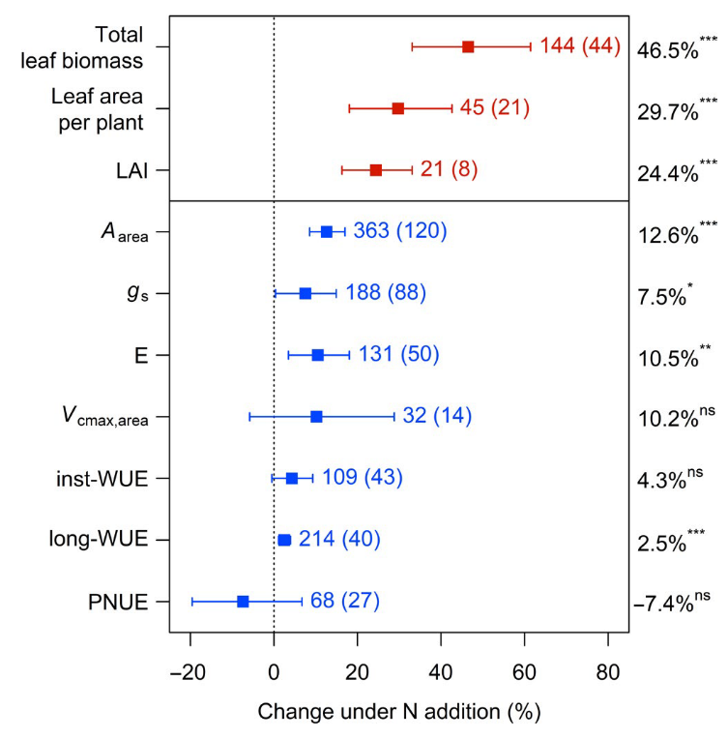
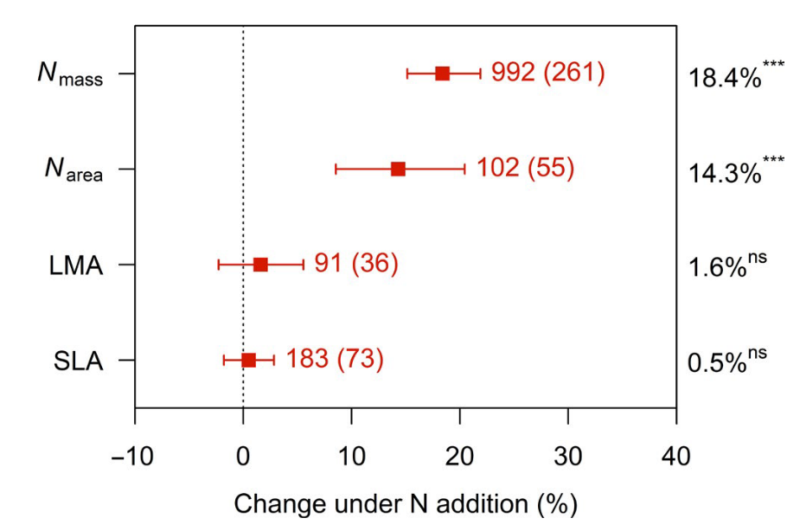
Empirical data supports this framework
Liang et al. (2020) Global Change Biology

Slide 11
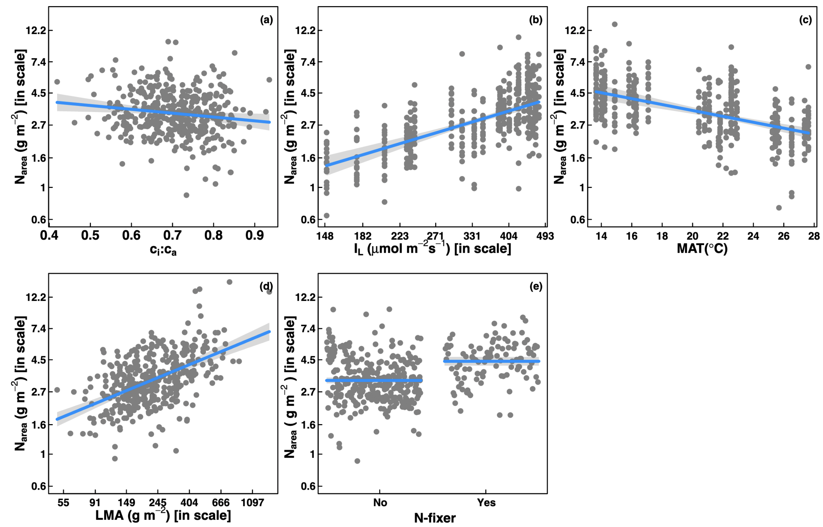
However, leaf nitrogen can be predicted independent of soil nitrogen…
Dong et al. (2017) Biogeosciences
Notes:
calls the use of these relationships in terrestrial biosphere models into question

Slide 12
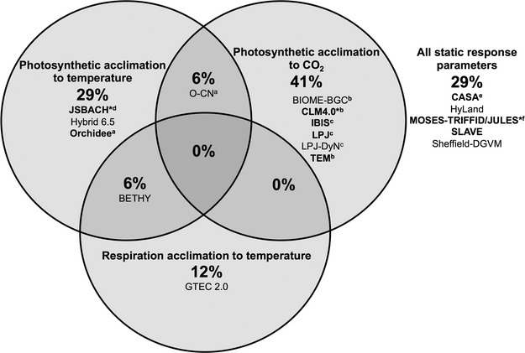
… and most TBMs do not invoke plant acclimation responses to changing environments
Smith & Dukes (2013) Global Change Biology

Slide 13
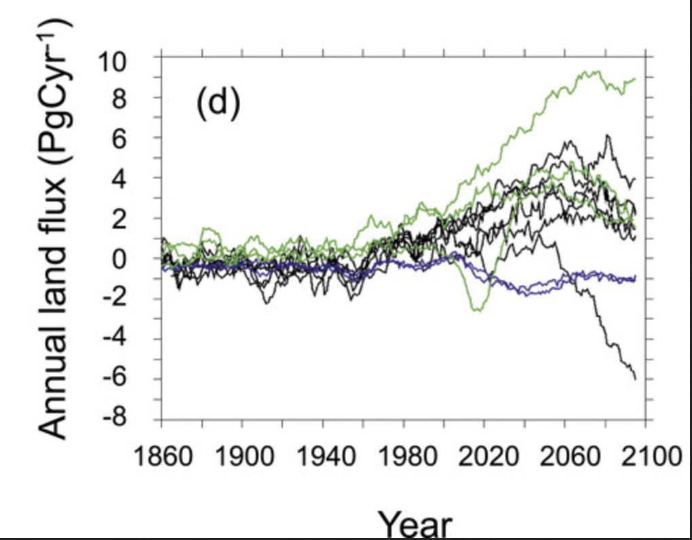
Therefore, the large divergence in TBM simulations under future environments…
Friedlingstein et al. (2014) Journal of Climate

Slide 14
Therefore, the large divergence in TBM simulations under future environments…
… may be the result of
uncertainty in the response of
photosynthetic processes to
future environmental conditions
Friedlingstein et al. (2014) Journal of Climate

Slide 15
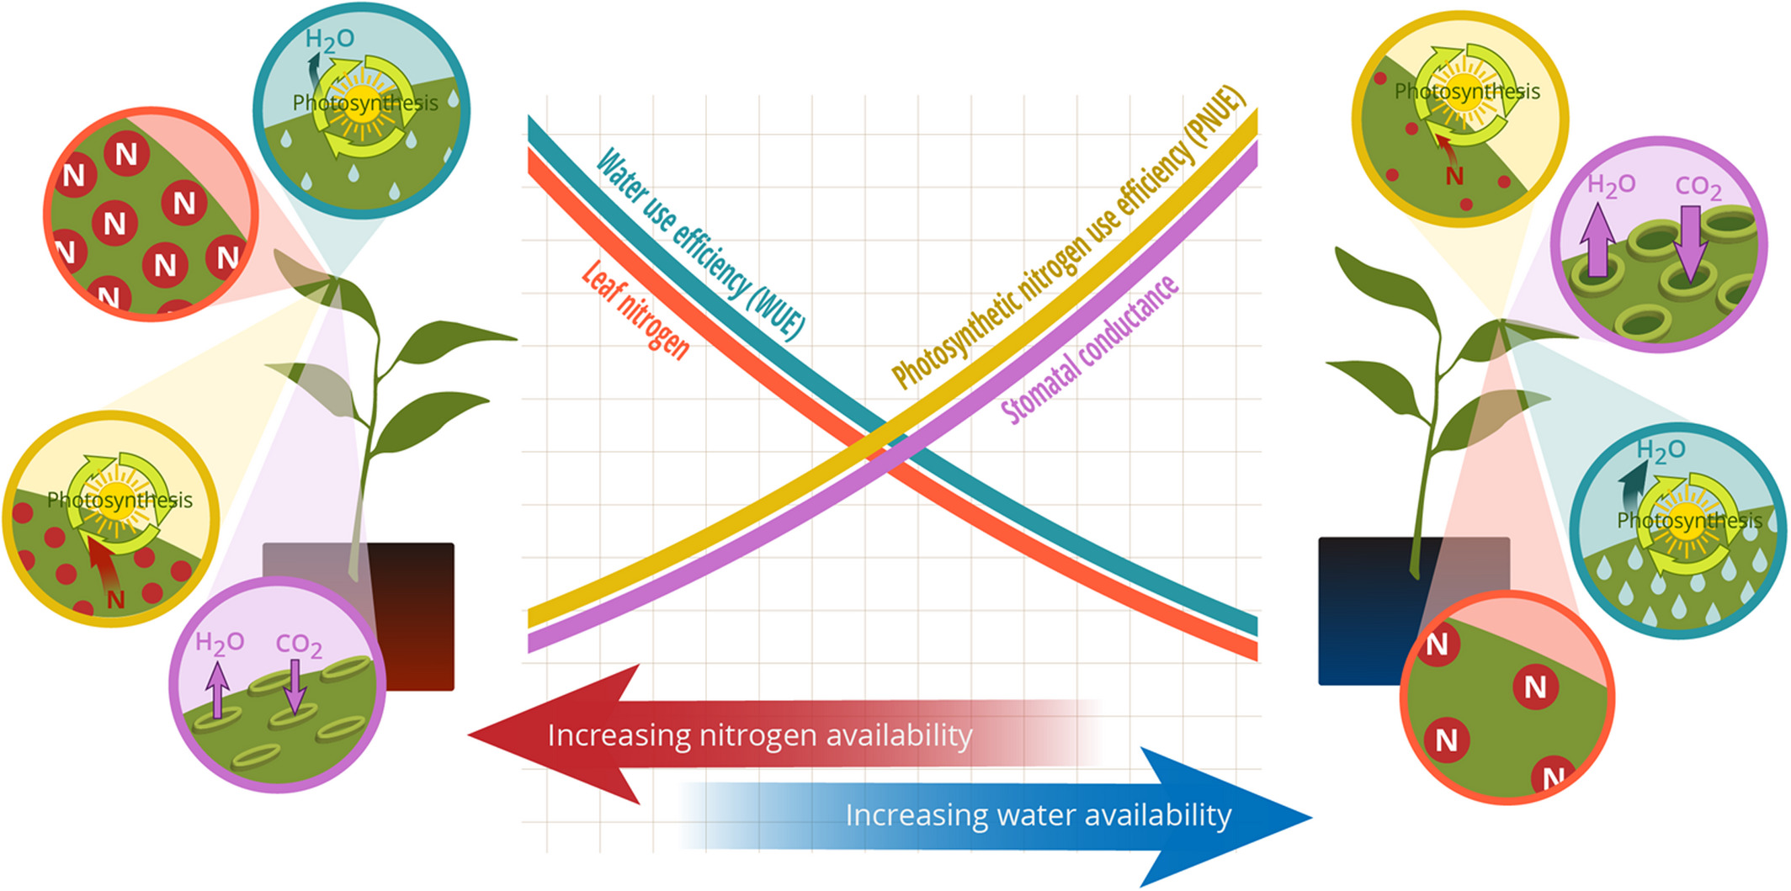
Photosynthetic least-cost theory: leaves acclimate to changing climatic and edaphic environments via summed cost of resource use (nitrogen and water)
Bialic-Murphy et al. (2021) Ecology Letters

Slide 16
Photosynthetic least-cost theory: leaves acclimate to changing climatic and edaphic environments via summed cost of resource use (nitrogen and water)
Bialic-Murphy et al. (2021) Ecology Letters

Slide 17
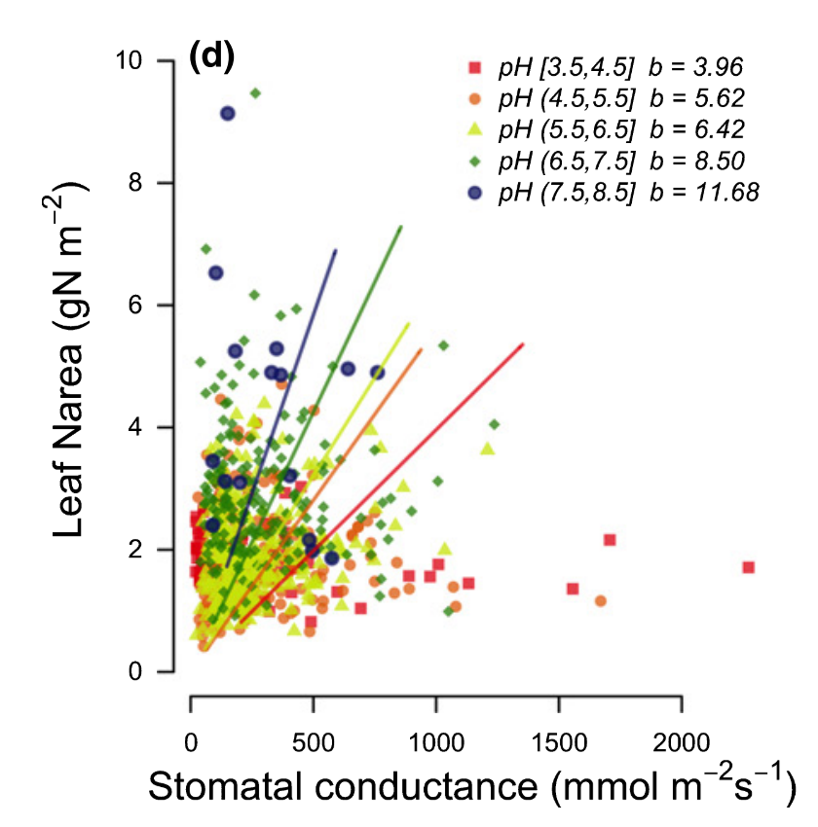
Recent work supports expected patterns at broad spatiotemporal scales
Paillassa et al. (2020) New Phytologist
Notes:
Empirical tests of the theory at finer spatiotemporal scales are sparse, particularly manipulative experiments that allow us to test mechanisms driving patterns expected from theory
Additionally, just one previous study leveraging patterns expected from the theory has quantified costs of nitrogen acquisition, which limits our ability to determine how these costs vary across environments

Slide 18
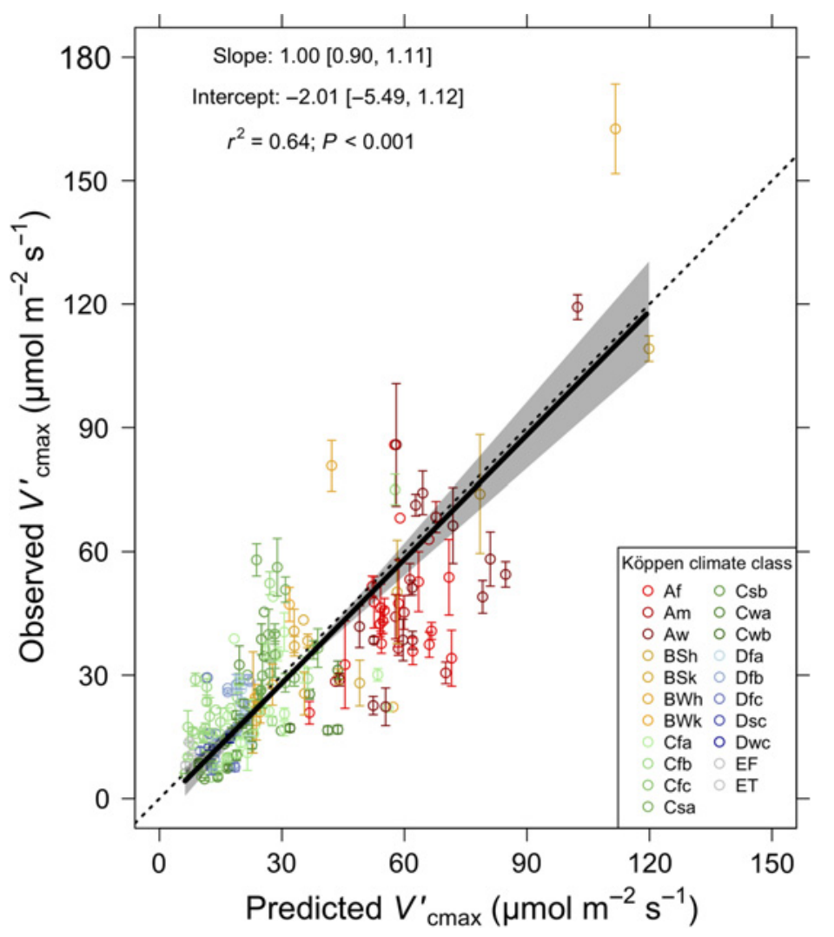
Recent work supports expected patterns at broad spatiotemporal scales
Paillassa et al. (2020) New Phytologist
Smith et al. (2019) Ecology Letters
Notes:
Empirical tests of the theory at finer spatiotemporal scales are sparse, particularly manipulative experiments that allow us to test mechanisms driving patterns expected from theory
Additionally, just one previous study leveraging patterns expected from the theory has quantified costs of nitrogen acquisition, which limits our ability to determine how these costs vary across environments

Slide 19
Dissertation Objectives
Vignette 1: How do costs of nitrogen acquisition vary across environments?

Slide 20
Dissertation Objectives
Vignette 1: How do costs of nitrogen acquisition vary across environments?
Vignette 2: To what extent do edaphic and climatic factors modify nitrogen-water use tradeoffs?

Slide 21
Dissertation Objectives
Vignette 1: How do costs of nitrogen acquisition vary across environments?
Vignette 2: To what extent do edaphic and climatic factors modify nitrogen-water use tradeoffs?
Vignette 3: How does soil nitrogen availability modify plant acclimation responses to elevated CO₂?

Slide 22
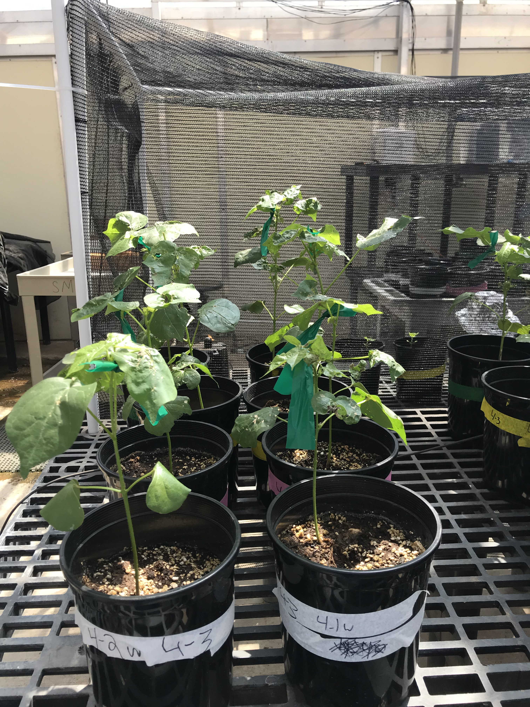
Structural carbon costs to acquire nitrogen are determined by nitrogen and light availability in two species with different nitrogen acquisition strategies
Vignette 1
Perkowski et al. (2021) Journal of Experimental Botany

Slide 23

Plant nitrogen acquisition is a process in terrestrial systems where carbon and nitrogen are tightly coupled
CO₂
Vignette 1
Schematic adapted from Brzostek et al. (2014) JGR Biogeosciences
Notes:
This is an overly simplistic schematic that I hope will demonstrate this
Plants draw carbon dioxide in from the atmosphere and convert this to simple sugars

Slide 24
Plant nitrogen acquisition is a process in terrestrial systems where carbon and nitrogen are tightly coupled
CO₂
NPP
Vignette 1
Schematic adapted from Brzostek et al. (2014) JGR Biogeosciences
Notes:
This supports net primary production, and allows plants to allocate carbon toward two primary pathways

Slide 25
Plant nitrogen acquisition is a process in terrestrial systems where carbon and nitrogen are tightly coupled
CO₂
NPP
C_{transfer}
C_{growth}
Vignette 1
Schematic adapted from Brzostek et al. (2014) JGR Biogeosciences
Notes:
First, plants might use carbon to support whole plant growth. This may be through woody tissue production, leaf production and maintenance, or toward storage
Alternatively, plants might use carbon to support soil resource uptake. This can either be through fine root production, root exudation, or carbon exchange with microbial symbionts

Slide 26
Plant nitrogen acquisition is a process in terrestrial systems where carbon and nitrogen are tightly coupled
CO₂
NPP
C_{transfer}
C_{growth}
N_{growth}
N_{available}
Vignette 1
Schematic adapted from Brzostek et al. (2014) JGR Biogeosciences
Notes:
Plants use carbon allocated belowground to acquire important resources that support photosynthetic and metabolic demand. While there are a ton of different nutrients plants acquire, plants acquire nitrogen in the largest quantity.
Once acquired, nitrogen can be used for maintenance of structural tissue, production and maintenance of photosynthetic enzymes, and many other important functions that are critical for the growth, reproduction, and survival of an individual plant.

Slide 27
Plant nitrogen acquisition is a process in terrestrial systems where carbon and nitrogen are tightly coupled
CO₂
There are inherent carbon costs associated with acquiring nitrogen
NPP
C_{transfer}
C_{growth}
N_{growth}
N_{available}
Vignette 1
Schematic adapted from Brzostek et al. (2014) JGR Biogeosciences
Notes:
However, plants are not able to acquire nitrogen without first allocating carbon belowground.
Thus, there are inherent carbon costs associated with acquiring nitrogen.
These can include structural carbon costs associated with root production and maintenance, or active carbon costs associated with exchange of carbon to microbial symbionts.

Slide 28
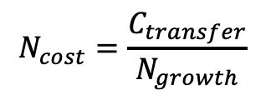
Plant nitrogen acquisition is a process in terrestrial systems where carbon and nitrogen are tightly coupled
CO₂
There are inherent carbon costs associated with acquiring nitrogen
NPP
C_{transfer}
C_{growth}
$$N_{cost}=\frac{C_{transfer}}{N_{growth}}$$
N_{growth}
N_{available}
Vignette 1
Schematic adapted from Brzostek et al. (2014) JGR Biogeosciences
Notes:
However, plants are not able to acquire nitrogen without first allocating carbon belowground.
Thus, there are inherent carbon costs associated with acquiring nitrogen.
These can include structural carbon costs associated with root production and maintenance, or active carbon costs associated with exchange of carbon to microbial symbionts.

Slide 29
Soil nitrogen availability may decrease carbon costs to acquire nitrogen as a function of increased per-root nitrogen uptake
CO₂
NPP
C_{transfer}
C_{growth}
N_{growth}
N_{available}
Vignette 1
Schematic adapted from Brzostek et al. (2014) JGR Biogeosciences
Notes:
Importantly, carbon costs to acquire nitrogen are dynamic and therefore are likely to change with changing aboveground and belowground environmental conditions.
Belowground, soil nitrogen availability likely plays an important role in modifying these carbon costs.
This is because increases in soil nitrogen availability do not influence plant demand to acquire soil resources, and therefore likely do not have a large impact on the magnitude of belowground carbon investments.
Thus, if plants acquire additional nitrogen without a proportional change in belowground carbon, then carbon costs to acquire nitrogen would likely decrease with increasing soil nitrogen availability.
This could be indexed through increased per-root nitrogen uptake in species that acquire most of their nitrogen through direct uptake

Slide 30
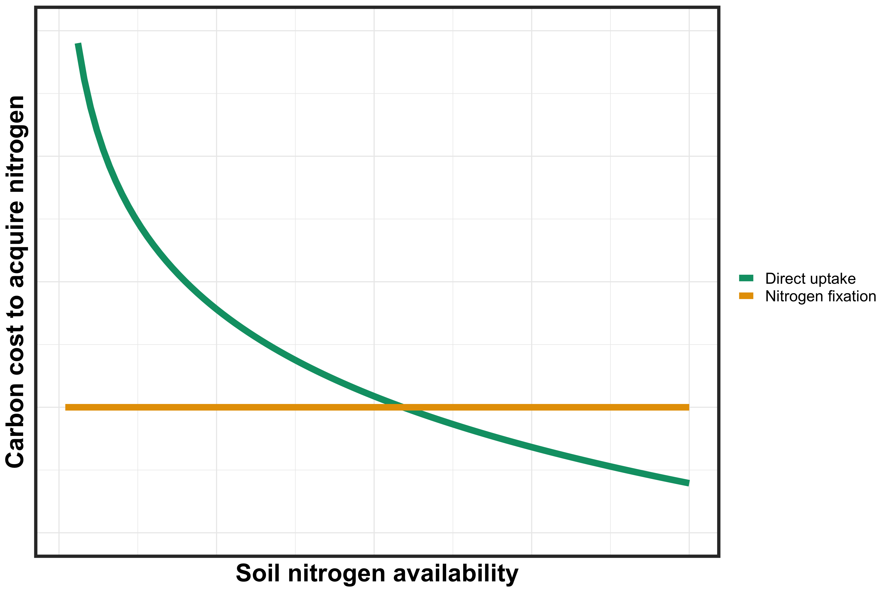
However, effects of soil nitrogen availability on carbon costs to acquire nitrogen may be context dependent on nitrogen acquisition strategy
Vignette 1
Notes:
It is important to note, however, that effects of soil nitrogen availability on carbon costs to acquire nitrogen may be context dependent on species nitrogen acquisition strategy.
This has been shown in several modeling studies and meta-analyses in species that associate with different types of mycorrhizal fungi, species that associate with nitrogen fixing bacteria, and species that acquire nitrogen mostly via direct uptake
This figure describes the hypothesized relationship between soil nitrogen availability, represented on the x-axis, and carbon costs to acquire nitrogen, represented on the y-axis between two nitrogen acquisition strategies

Slide 31
However, effects of soil nitrogen availability on carbon costs to acquire nitrogen may be context dependent on nitrogen acquisition strategy
Vignette 1
Notes:
Species that associate with nitrogen-fixing bacteria are represented by a yellow trendline and species that acquire nitrogen via direct uptake are represented by a green trendline

Slide 32
However, effects of soil nitrogen availability on carbon costs to acquire nitrogen may be context dependent on nitrogen acquisition strategy
Vignette 1
Notes:
You can see that species that associate with nitrogen-fixing bacteria have lower carbon costs to acquire nitrogen than species that acquire nitrogen via direct uptake when soil nitrogen is less available.
This may pose a competitive advantage to species that associate with nitrogen fixing bacteria, as species would be able to acquire more nitrogen from a carbon investment
However, as soil nitrogen availability increases, species that acquire nitrogen via direct uptake experience decreased carbon costs to acquire nitrogen, likely as a function of increased per-root nitrogen uptake.
Eventually, this may lead to a scenario where it is more advantageous for species to acquire nitrogen from direct uptake pathways than through nitrogen fixation, and could cause nitrogen-fixing species to switch away from nitrogen fixation to direct uptake to maximize nitrogen uptake from a belowground carbon investment

Slide 33
However, effects of soil nitrogen availability on carbon costs to acquire nitrogen may be context dependent on nitrogen acquisition strategy
Individual switches to more efficient acquisition pathway
Vignette 1
Notes:
You can see that species that associate with nitrogen-fixing bacteria have lower carbon costs to acquire nitrogen than species that acquire nitrogen via direct uptake when soil nitrogen is less available.
This may pose a competitive advantage to species that associate with nitrogen fixing bacteria, as species would be able to acquire more nitrogen from a carbon investment
However, as soil nitrogen availability increases, species that acquire nitrogen via direct uptake experience decreased carbon costs to acquire nitrogen, likely as a function of increased per-root nitrogen uptake.
Eventually, this may lead to a scenario where it is more advantageous for species to acquire nitrogen from direct uptake pathways than through nitrogen fixation, and could cause nitrogen-fixing species to switch away from nitrogen fixation to direct uptake to maximize nitrogen uptake from a belowground carbon investment

Slide 34
Light availability may increase plant carbon costs to acquire nitrogen as a function of increased plant nitrogen demand
CO₂
NPP
C_{transfer}
C_{growth}
N_{growth}
N_{available}
Vignette 1
Schematic adapted from Brzostek et al. (2014) JGR Biogeosciences
Notes:
Finally, aboveground environmental conditions may influence carbon costs to acquire nitrogen
Specifically, environmental conditions that increase NPP and increase plant demand to acquire soil resources should increase carbon costs to acquire nitrogen over short temporal scales.
These patterns would likely be indexed through larger belowground carbon investments relative to nitrogen uptake
For example, increased light availability should increase net primary productivity, which should increase belowground carbon investments in order to acquire additional nitrogen to support higher NPP.
However, over short temporal scales, this may not correspond with an increase in plant nitrogen uptake.
This is because it takes time to build structures and exchange carbon with microbial symbionts, so there is likely a temporal lag between the time it takes to allocate carbon belowground and acquire additional nitrogen

Slide 35
Light availability may increase plant carbon costs to acquire nitrogen as a function of increased plant nitrogen demand
CO₂
NPP
Increased plant nitrogen demand should increase belowground carbon investments
C_{transfer}
C_{growth}
N_{growth}
N_{available}
Vignette 1
Schematic adapted from Brzostek et al. (2014) JGR Biogeosciences
Notes:
Finally, aboveground environmental conditions may influence carbon costs to acquire nitrogen
Specifically, environmental conditions that increase NPP and increase plant demand to acquire soil resources should increase carbon costs to acquire nitrogen over short temporal scales.
These patterns would likely be indexed through larger belowground carbon investments relative to nitrogen uptake
For example, increased light availability should increase net primary productivity, which should increase belowground carbon investments in order to acquire additional nitrogen to support higher NPP.
However, over short temporal scales, this may not correspond with an increase in plant nitrogen uptake.
This is because it takes time to build structures and exchange carbon with microbial symbionts, so there is likely a temporal lag between the time it takes to allocate carbon belowground and acquire additional nitrogen

Slide 36



Experiment setup
Lizz Waring
Light availability treatments
Soil fertilization treatments
Species
0% shade cover
0 ppm N
Gossypium
hirsutum
30% shade cover
70 ppm N
50% shade cover
210 ppm N
Glycine
max
80% shade cover
630 ppm N
Vignette 1
Perkowski et al. (2021) Journal of Experimental Botany

Slide 37
Measurements
Root carbon biomass
Carbon cost to acquire nitrogen
=
Whole plant nitrogen biomass
Vignette 1
Perkowski et al. (2021) Journal of Experimental Botany
Notes:
We quantified carbon costs to acquire nitrogen as a function of root carbon biomass and whole-plant nitrogen biomass.
There are several limitations associated with this metric that I unfortunately do not have time to get into here. If you want more information about this metric, I’ve linked a QR code at the end of this talk to our recently accepted manuscript on this work.

Slide 38
Hypotheses
Positive effect
Negative effect
G. max carbon costs to acquire nitrogen
Light availability
G. hirsutum carbon costs to acquire nitrogen
Vignette 1
Perkowski et al. (2021) Journal of Experimental Botany
Notes:
We used this experiment to test the following hypotheses
Light availability would impact carbon costs to acquire nitrogen similarly in both species.
This would likely be indexed by a larger increase in root carbon biomass than whole plant nitrogen biomass due to the short temporal scale of this study
However, we expected that nitrogen availability would impact carbon costs to acquire nitrogen differently between species
We expected that carbon costs to acquire nitrogen would decrease with increasing soil nitrogen fertilization in G. hirsutum due to an increase in per-root nitrogen uptake
However, we expected that these carbon costs would not change with soil nitrogen fertilization in G. max. This is because G. max would acquire most of its nitrogen from nitrogen fixation and independent of soil nitrogen fertilization

Slide 39
Hypotheses
Positive effect
Negative effect
G. max carbon costs to acquire nitrogen
Light availability
G. hirsutum carbon costs to acquire nitrogen
Nitrogen fertilization
Vignette 1
Perkowski et al. (2021) Journal of Experimental Botany
Notes:
We used this experiment to test the following hypotheses
Light availability would impact carbon costs to acquire nitrogen similarly in both species.
This would likely be indexed by a larger increase in root carbon biomass than whole plant nitrogen biomass due to the short temporal scale of this study
However, we expected that nitrogen availability would impact carbon costs to acquire nitrogen differently between species
We expected that carbon costs to acquire nitrogen would decrease with increasing soil nitrogen fertilization in G. hirsutum due to an increase in per-root nitrogen uptake
However, we expected that these carbon costs would not change with soil nitrogen fertilization in G. max. This is because G. max would acquire most of its nitrogen from nitrogen fixation and independent of soil nitrogen fertilization

Slide 40
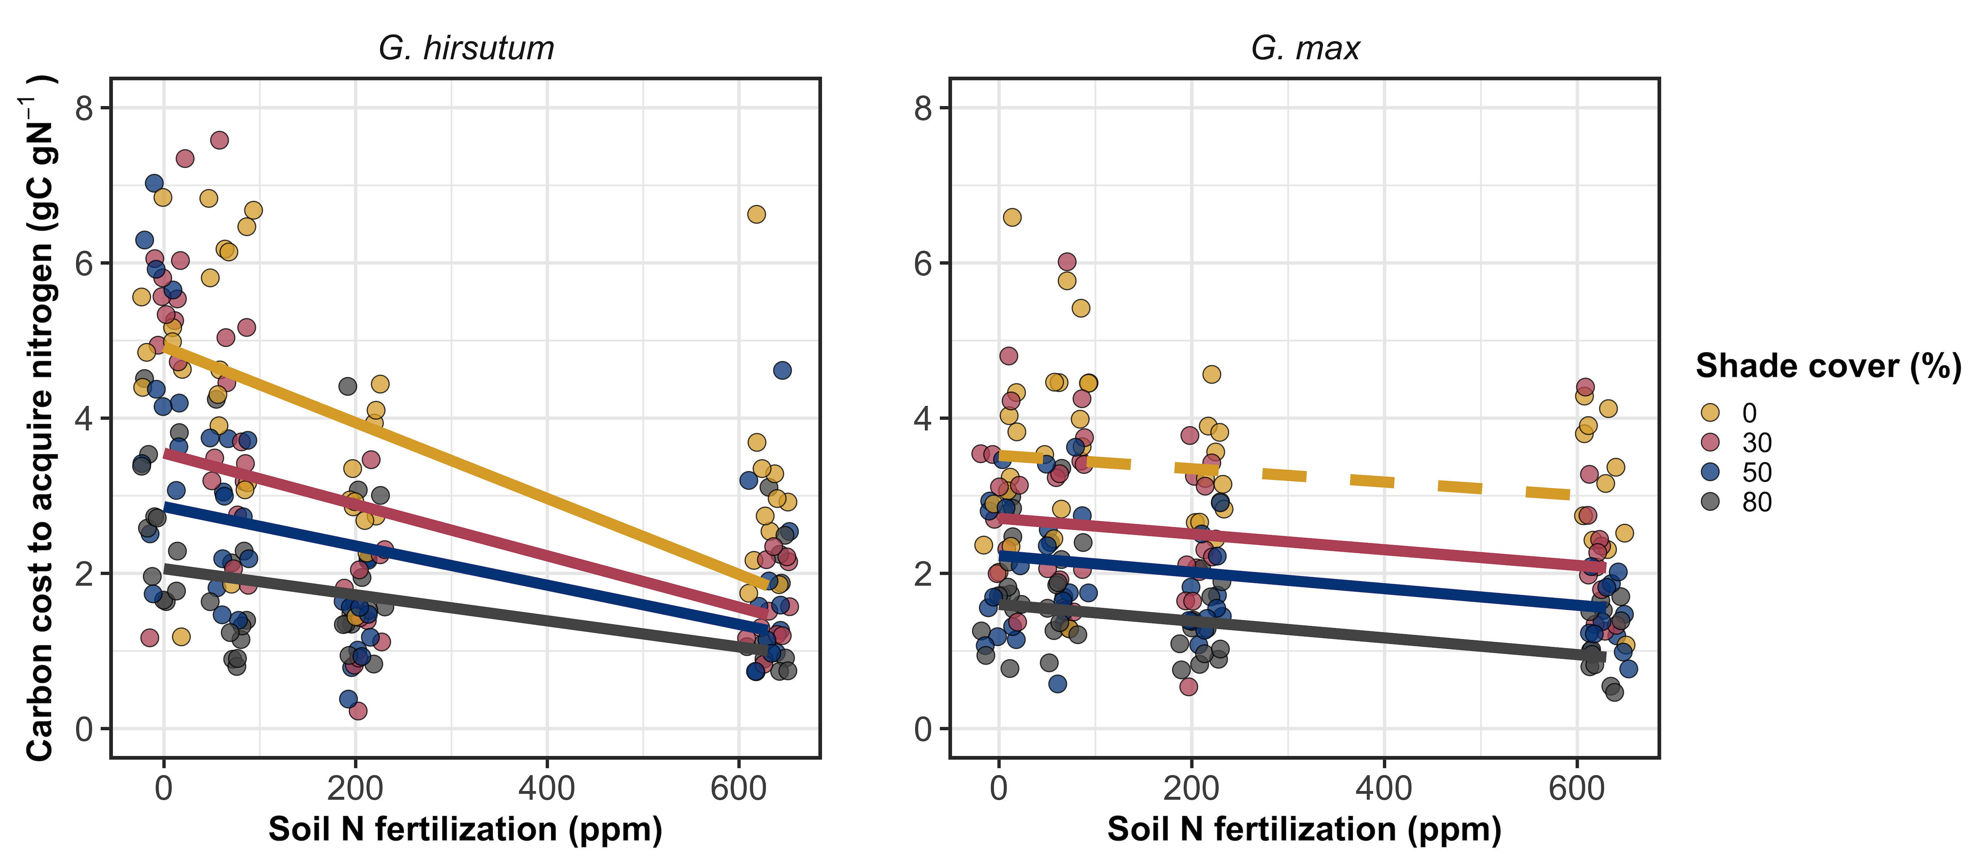
Carbon costs to acquire nitrogen decreased with increasing fertilization, but increased with increasing light availability
Vignette 1
Perkowski et al. (2021) Journal of Experimental Botany

Slide 41
Carbon costs to acquire nitrogen decreased with increasing fertilization, but increased with increasing light availability
Vignette 1
Perkowski et al. (2021) Journal of Experimental Botany

Slide 42
Carbon costs to acquire nitrogen decreased with increasing fertilization, but increased with increasing light availability
Vignette 1
G. max generally less responsive to soil nitrogen availability
Perkowski et al. (2021) Journal of Experimental Botany

Slide 43
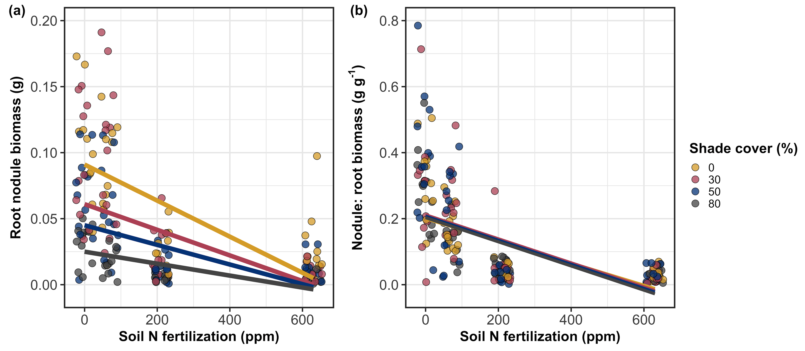
Reduced response of G. max to soil nitrogen may be due to reduced investment in root nodules
Vignette 1
Perkowski et al. (2021) Journal of Experimental Botany

Slide 44
Vignette 1
G. max carbon costs to acquire nitrogen
Light availability
G. hirsutum carbon costs to acquire nitrogen
Nitrogen fertilization
Vignette 1
Perkowski et al. (2021) Journal of Experimental Botany
Notes:
We used this experiment to test the following hypotheses
Light availability would impact carbon costs to acquire nitrogen similarly in both species.
This would likely be indexed by a larger increase in root carbon biomass than whole plant nitrogen biomass due to the short temporal scale of this study
However, we expected that nitrogen availability would impact carbon costs to acquire nitrogen differently between species
We expected that carbon costs to acquire nitrogen would decrease with increasing soil nitrogen fertilization in G. hirsutum due to an increase in per-root nitrogen uptake
However, we expected that these carbon costs would not change with soil nitrogen fertilization in G. max. This is because G. max would acquire most of its nitrogen from nitrogen fixation and independent of soil nitrogen fertilization

Slide 45

Vignette 1
G. max carbon costs to acquire nitrogen
Light availability
G. hirsutum carbon costs to acquire nitrogen
Nitrogen fertilization
Vignette 1
Perkowski et al. (2021) Journal of Experimental Botany
Notes:
We used this experiment to test the following hypotheses
Light availability would impact carbon costs to acquire nitrogen similarly in both species.
This would likely be indexed by a larger increase in root carbon biomass than whole plant nitrogen biomass due to the short temporal scale of this study
However, we expected that nitrogen availability would impact carbon costs to acquire nitrogen differently between species
We expected that carbon costs to acquire nitrogen would decrease with increasing soil nitrogen fertilization in G. hirsutum due to an increase in per-root nitrogen uptake
However, we expected that these carbon costs would not change with soil nitrogen fertilization in G. max. This is because G. max would acquire most of its nitrogen from nitrogen fixation and independent of soil nitrogen fertilization

Slide 46
Vignette 1
G. max carbon costs to acquire nitrogen
Light availability
G. hirsutum carbon costs to acquire nitrogen
Nitrogen fertilization
Vignette 1
Perkowski et al. (2021) Journal of Experimental Botany
Notes:
We used this experiment to test the following hypotheses
Light availability would impact carbon costs to acquire nitrogen similarly in both species.
This would likely be indexed by a larger increase in root carbon biomass than whole plant nitrogen biomass due to the short temporal scale of this study
However, we expected that nitrogen availability would impact carbon costs to acquire nitrogen differently between species
We expected that carbon costs to acquire nitrogen would decrease with increasing soil nitrogen fertilization in G. hirsutum due to an increase in per-root nitrogen uptake
However, we expected that these carbon costs would not change with soil nitrogen fertilization in G. max. This is because G. max would acquire most of its nitrogen from nitrogen fixation and independent of soil nitrogen fertilization

Slide 47
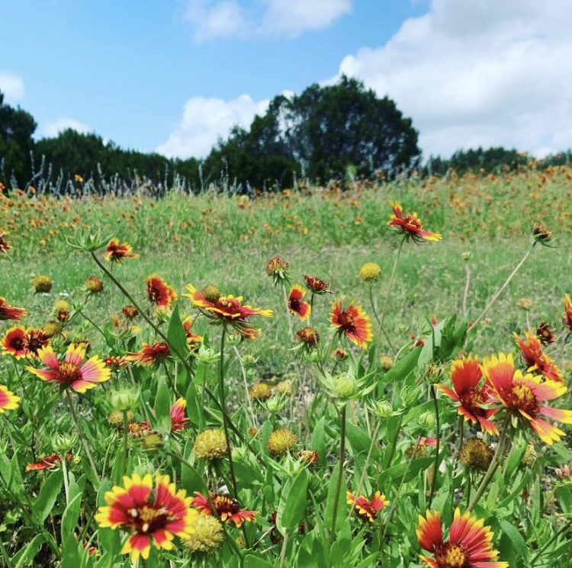
The relative cost of resource use for photosynthesis drives variance in leaf nitrogen content across a climate and soil resource availability gradient
Vignette 1
Vignette 2
Perkowski & Smith (in prep)

Slide 48
Photosynthetic least-cost theory: leaves acclimate to changing climatic and edaphic environments via summed cost of resource use (nitrogen and water)
Vignette 1
Vignette 2
Bialic-Murphy et al. (2021) Ecology Letters
Notes:
At the leaf level, plants might allocate nitrogen to photosynthetic leaf tissue in order to preserve water
This option can be explained through recent frameworks suggesting that plants can and should maximize photosynthetic carbon gain by trading inefficient use of an abundant resource for efficiency a more limited limiting resource.
For example, if nitrogen is relatively more available than water, then plants can maintain a similar photosynthetic output by increasing nitrogen allocation toward photosynthetic leaf tissue in order to increase water-use efficiency., effectively employing a water-savings mechanism
We might expect these patterns would be observed in arid systems where water is relatively less available than nitrogen, although these patterns haven’t necessarily been tested in temperate regions

Slide 49
β is held constant in least-cost optimality models, but evidence suggests that β varies across environments
Vignette 1
Vignette 2
Perkowski et al. (2021) Journal of Experimental Botany

Slide 50
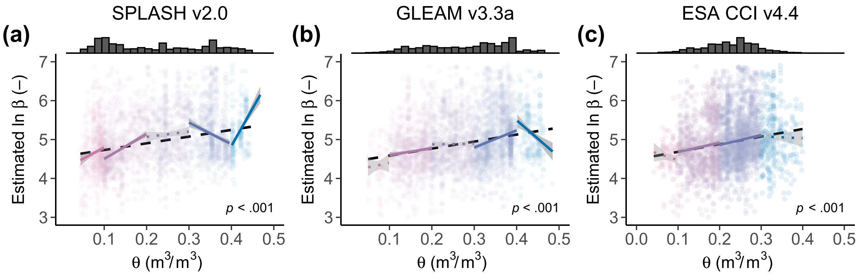
β is held constant in least-cost optimality models, but evidence suggests that β varies across environments
Vignette 1
Vignette 2
Lavergne et al. (2020) Global Change Biology

Slide 51
Open questions
How dynamic are costs to acquire nitrogen relative to water across edaphic and climatic gradients?
To what extent do costs to acquire nitrogen relative to water determine variance in leaf nitrogen content across environmental gradients?
Vignette 1
Vignette 2

Slide 52
Hypotheses
SM₉₀
N_{fixer}
VPD₄
N_{mass}
Positive
Negative
β
C_{i}:C_{a}
Ν_{area}
Vignette 1
Soil N
C₃/C₄
M_{area}
Vignette 2
Perkowski & Smith (in prep)

Slide 53
The cost of acquiring and using nutrients (β) will be modified by soil resources and species identity
SM₉₀
N_{fixer}
VPD₄
N_{mass}
Positive
Negative
β
C_{i}:C_{a}
Ν_{area}
Vignette 1
Soil N
C₃/C₄
M_{area}
Vignette 2
Perkowski & Smith (in prep)

Slide 54
Leaf C_{i}:C_{a} will be modified by costs of resource use and aboveground climate
SM₉₀
N_{fixer}
VPD₄
N_{mass}
Positive
Negative
β
C_{i}:C_{a}
Ν_{area}
Vignette 1
Soil N
C₃/C₄
M_{area}
Vignette 2
Perkowski & Smith (in prep)

Slide 55
Leaf nitrogen content will be negatively related to leaf C_{i}:C_{a}
SM₉₀
N_{fixer}
VPD₄
N_{mass}
Positive
Negative
β
C_{i}:C_{a}
Ν_{area}
Vignette 1
Soil N
C₃/C₄
M_{area}
Vignette 2
Perkowski & Smith (in prep)

Slide 56
Soil N may directly increase N_{area} due to increasing N_{mass}…
SM₉₀
N_{fixer}
VPD₄
N_{mass}
Positive
Negative
β
C_{i}:C_{a}
Ν_{area}
Vignette 1
Soil N
C₃/C₄
M_{area}
Vignette 2
Perkowski & Smith (in prep)

Slide 57
… or may indirectly increase N_{area} due to reductions in the cost of acquiring nitrogen
SM₉₀
N_{fixer}
VPD₄
N_{mass}
Positive
Negative
β
C_{i}:C_{a}
Ν_{area}
Vignette 1
Soil N
C₃/C₄
M_{area}
Vignette 2
Perkowski & Smith (in prep)

Slide 58
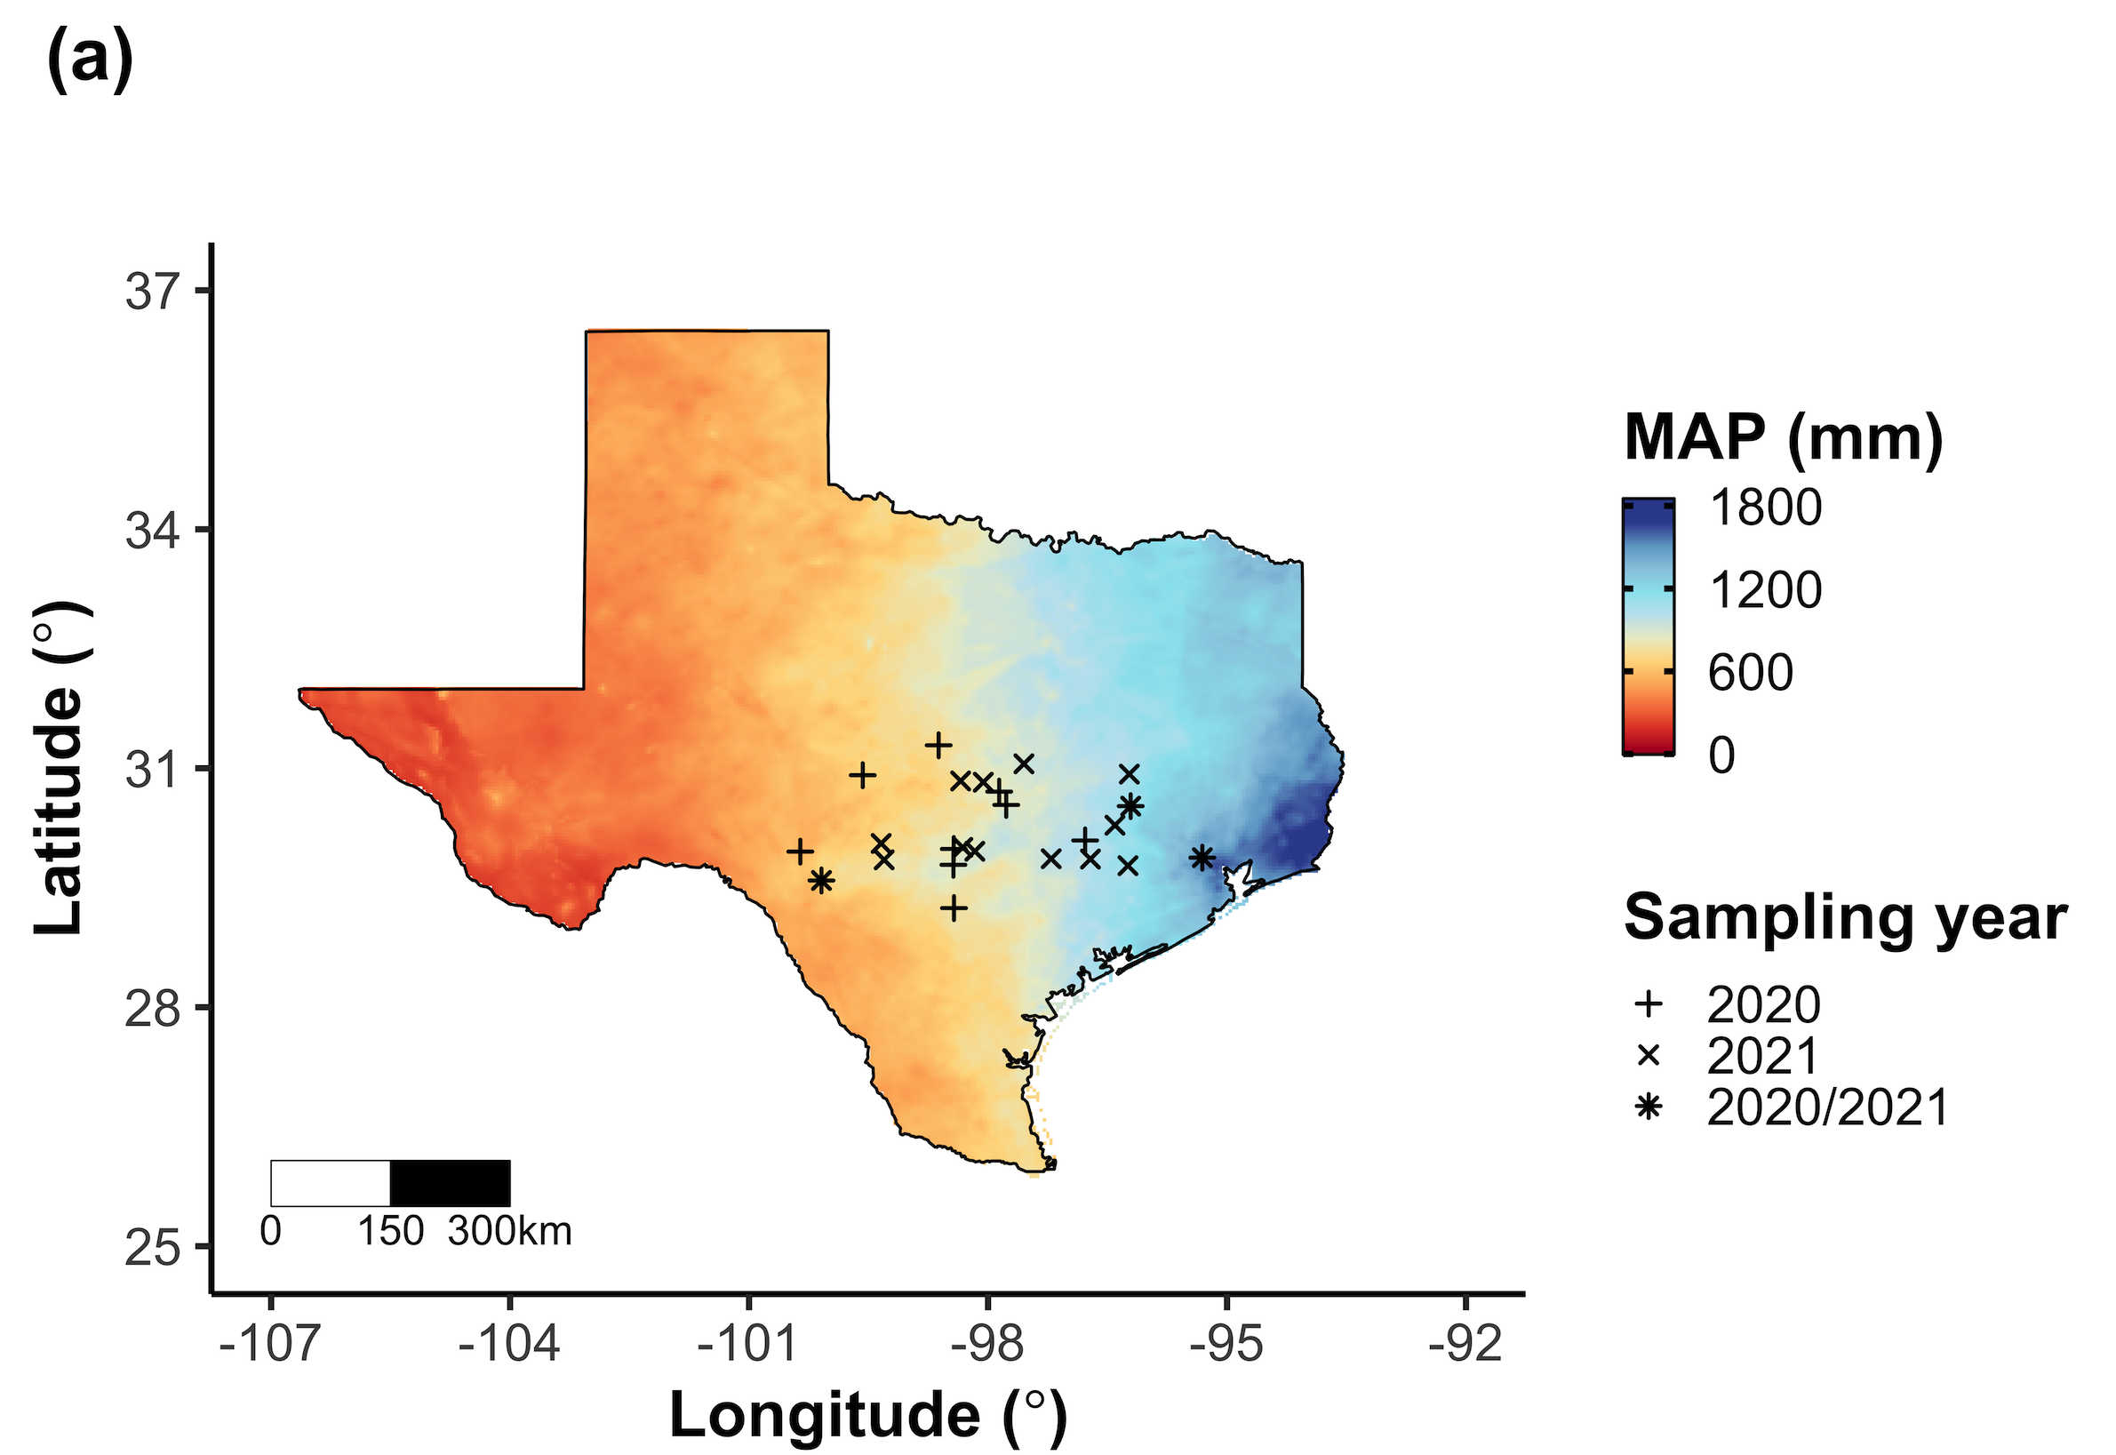
Field gradient experiment
24 sites
12 in 2020
15 in 2021 (3 from 2020)
3 leaves of 5 most dominant species at each site
Leaf nitrogen content
Leaf C_{i}:C_{a} (δ¹³C)
Cost of acquiring nitrogen relative to water (β)
Composite soil sample
Vignette 1
Vignette 2
Perkowski & Smith (in prep)

Slide 59
Field gradient experiment
Climate characteristics
Daily vapor pressure deficit
Edaphic characteristics
Soil nitrogen availability (NO₃-N)
Soil moisture
Timescales for vapor pressure deficit and soil moisture determined using model selection
Vignette 1
Vignette 2
Perkowski & Smith (in prep)

Slide 60
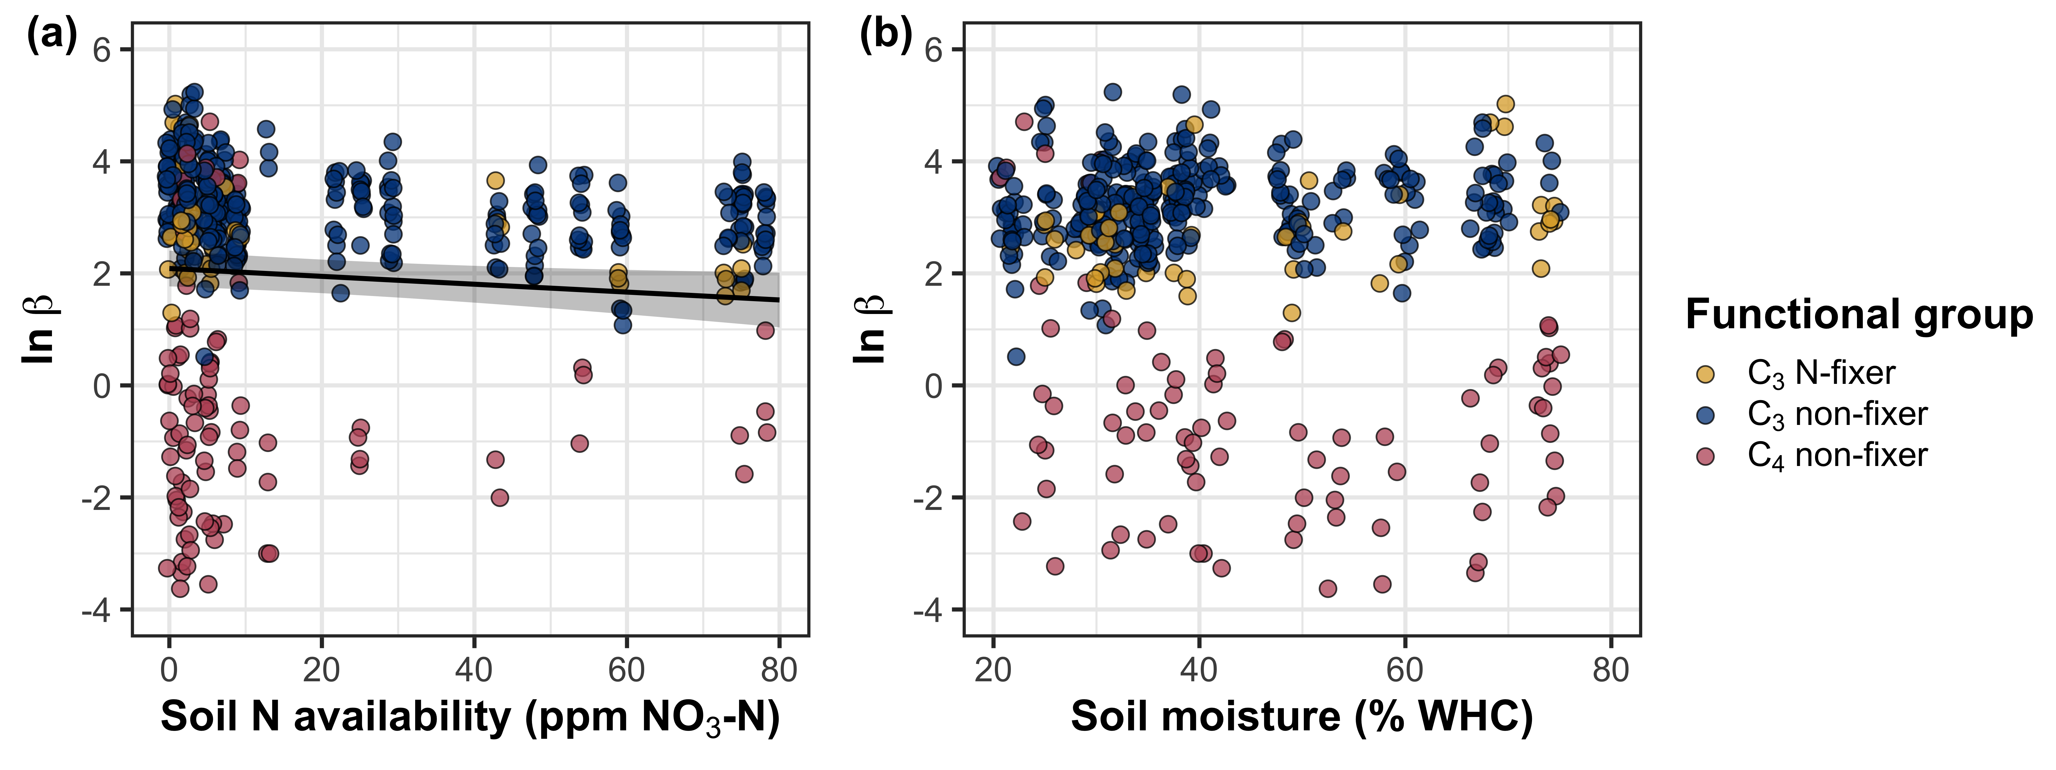
β decreases with increasing soil nitrogen, but is not modified by soil moisture
Vignette 1
Vignette 2
Perkowski & Smith (in prep)

Slide 61
β decreases with increasing soil nitrogen, but is not modified by soil moisture
Vignette 1
Vignette 2
Perkowski & Smith (in prep)

Slide 62
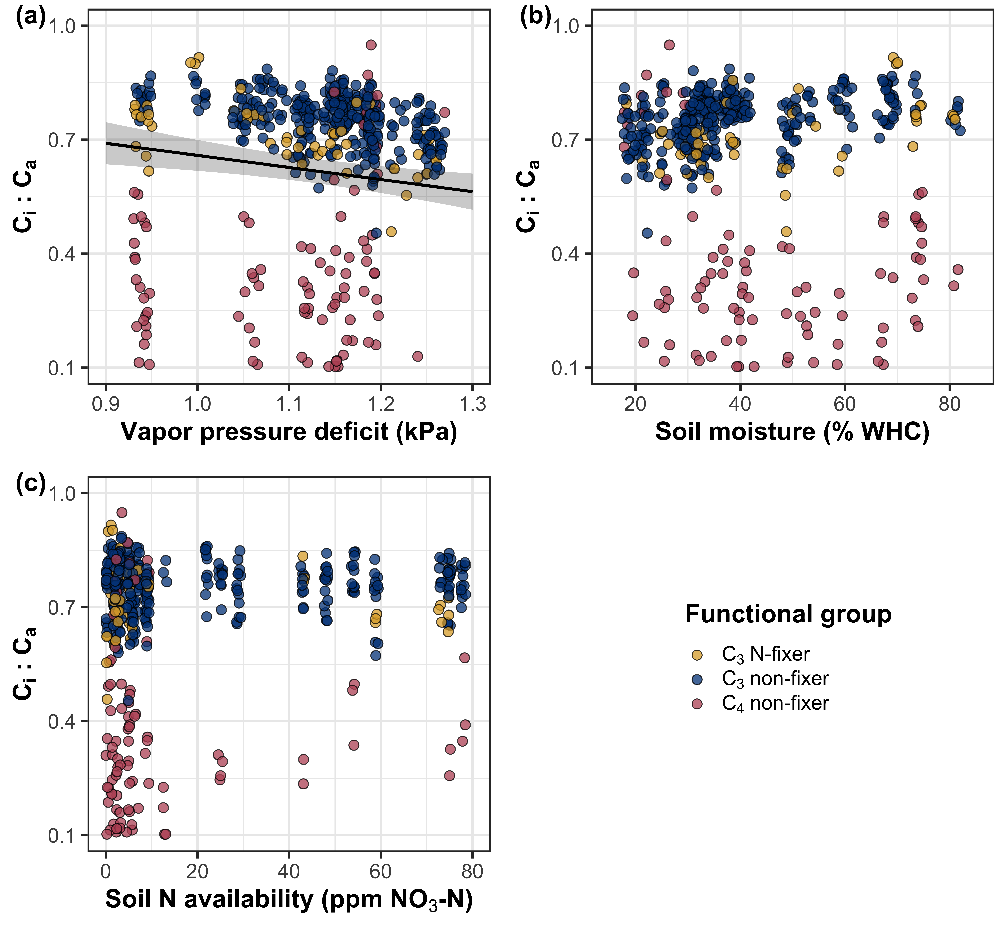
Leaf C_{i}:C_{a} decreases with increasing vapor pressure deficit, but is not modified by soil resource availability
Vignette 1
Vignette 2
Perkowski & Smith (in prep)

Slide 63
N_{area} increases with increasing soil nitrogen availability
Vignette 1
Vignette 2
Perkowski & Smith (in prep)

Slide 64
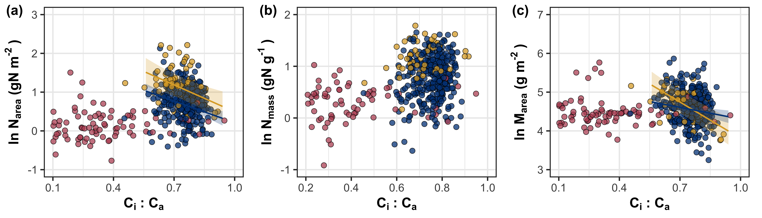
N_{area} is negatively associated with leaf C_{i}:C_{a} due to reductions in M_{area}
Vignette 1
Vignette 2
Perkowski & Smith (in prep)

Slide 65
β is negatively associated with increasing soil nitrogen, and generally lower in C₄ species
SM₉₀
N_{fixer}
VPD₄
N_{mass}
Positive
Negative
β
C_{i}:C_{a}
Ν_{area}
Vignette 1
Soil N
C₃/C₄
M_{area}
Vignette 2
Perkowski & Smith (in prep)

Slide 66
Leaf C_{i}:C_{a} is negatively related to increasing vapor pressure deficit and positively related to β
SM₉₀
N_{fixer}
VPD₄
N_{mass}
Positive
Negative
β
C_{i}:C_{a}
Ν_{area}
Vignette 1
Soil N
C₃/C₄
M_{area}
Vignette 2
Perkowski & Smith (in prep)

Slide 67
M_{area} is negatively related to leaf C_{i}:C_{a}, while N_{mass} is positively related to leaf C_{i}:C_{a}
SM₉₀
N_{fixer}
VPD₄
N_{mass}
Positive
Negative
β
C_{i}:C_{a}
Ν_{area}
Vignette 1
Soil N
C₃/C₄
M_{area}
Vignette 2
Perkowski & Smith (in prep)

Slide 68
Increasing soil nitrogen availability directly increases N_{mass} and decreases M_{area}
SM₉₀
N_{fixer}
VPD₄
N_{mass}
Positive
Negative
β
C_{i}:C_{a}
Ν_{area}
Vignette 1
Soil N
C₃/C₄
M_{area}
Vignette 2
Perkowski & Smith (in prep)

Slide 69
N-fixation ability directly increased N_{mass}
SM₉₀
N_{fixer}
VPD₄
N_{mass}
Positive
Negative
β
C_{i}:C_{a}
Ν_{area}
Vignette 1
Soil N
C₃/C₄
M_{area}
Vignette 2
Perkowski & Smith (in prep)

Slide 70
M_{area} is negatively associated with N_{mass}
SM₉₀
N_{fixer}
VPD₄
N_{mass}
Positive
Negative
β
C_{i}:C_{a}
Ν_{area}
Vignette 1
Soil N
C₃/C₄
M_{area}
Vignette 2
Perkowski & Smith (in prep)

Slide 71
Soil moisture was positively associated with soil nitrogen availability
SM₉₀
N_{fixer}
VPD₄
N_{mass}
Positive
Negative
β
C_{i}:C_{a}
Ν_{area}
Vignette 1
Soil N
C₃/C₄
M_{area}
Vignette 2
Perkowski & Smith (in prep)

Slide 72
Soil N directly increased N_{area} due to changes in N_{mass}…
SM₉₀
N_{fixer}
VPD₄
N_{mass}
Positive
Negative
β
C_{i}:C_{a}
Ν_{area}
Vignette 1
Soil N
C₃/C₄
M_{area}
Vignette 2
Perkowski & Smith (in prep)

Slide 73
… and indirectly increased N_{area} through reductions in β
SM₉₀
N_{fixer}
VPD₄
N_{mass}
Positive
Negative
β
C_{i}:C_{a}
Ν_{area}
Vignette 1
Soil N
C₃/C₄
M_{area}
Vignette 2
Perkowski & Smith (in prep)

Slide 74
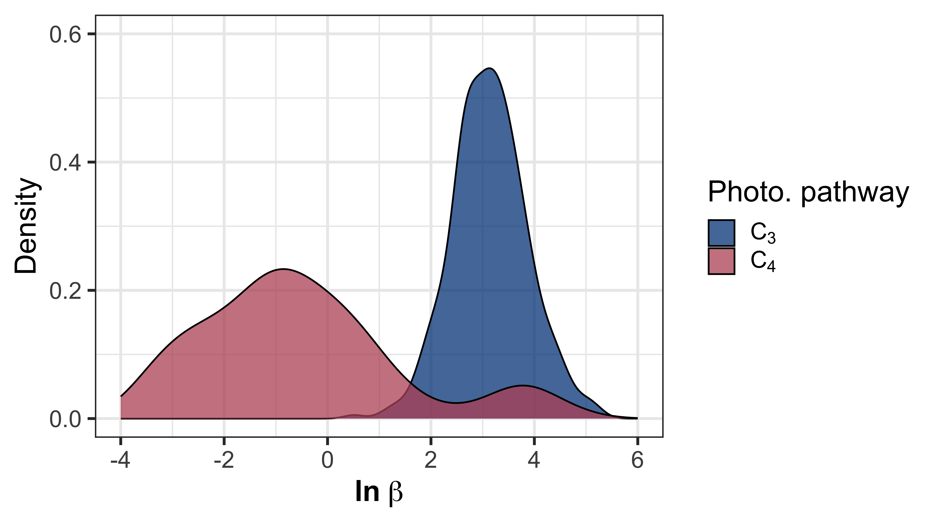
Conclusions
β dynamically changes across environments
Soil N is more important for determining variance in β than soil moisture
Leaf N is a direct and indirect product of soil N availability
Vignette 1
Vignette 2
Perkowski & Smith (in prep)

Slide 75
Conclusions
β dynamically changes across environments
Soil N is more important for determining variance in β than soil moisture
Leaf N is a direct and indirect product of soil N availability
SM₉₀
N_{fixer}
β
Soil N
C₃/C₄
Vignette 1
Vignette 2
Perkowski & Smith (in prep)

Slide 76
Conclusions
β dynamically changes across environments
Soil N is more important for determining variance in β than soil moisture
Leaf N is a direct and indirect product of soil N availability
N_{mass}
β
C_{i}:C_{a}
Ν_{area}
Soil N
M_{area}
Vignette 1
Vignette 2
Perkowski & Smith (in prep)

Slide 77
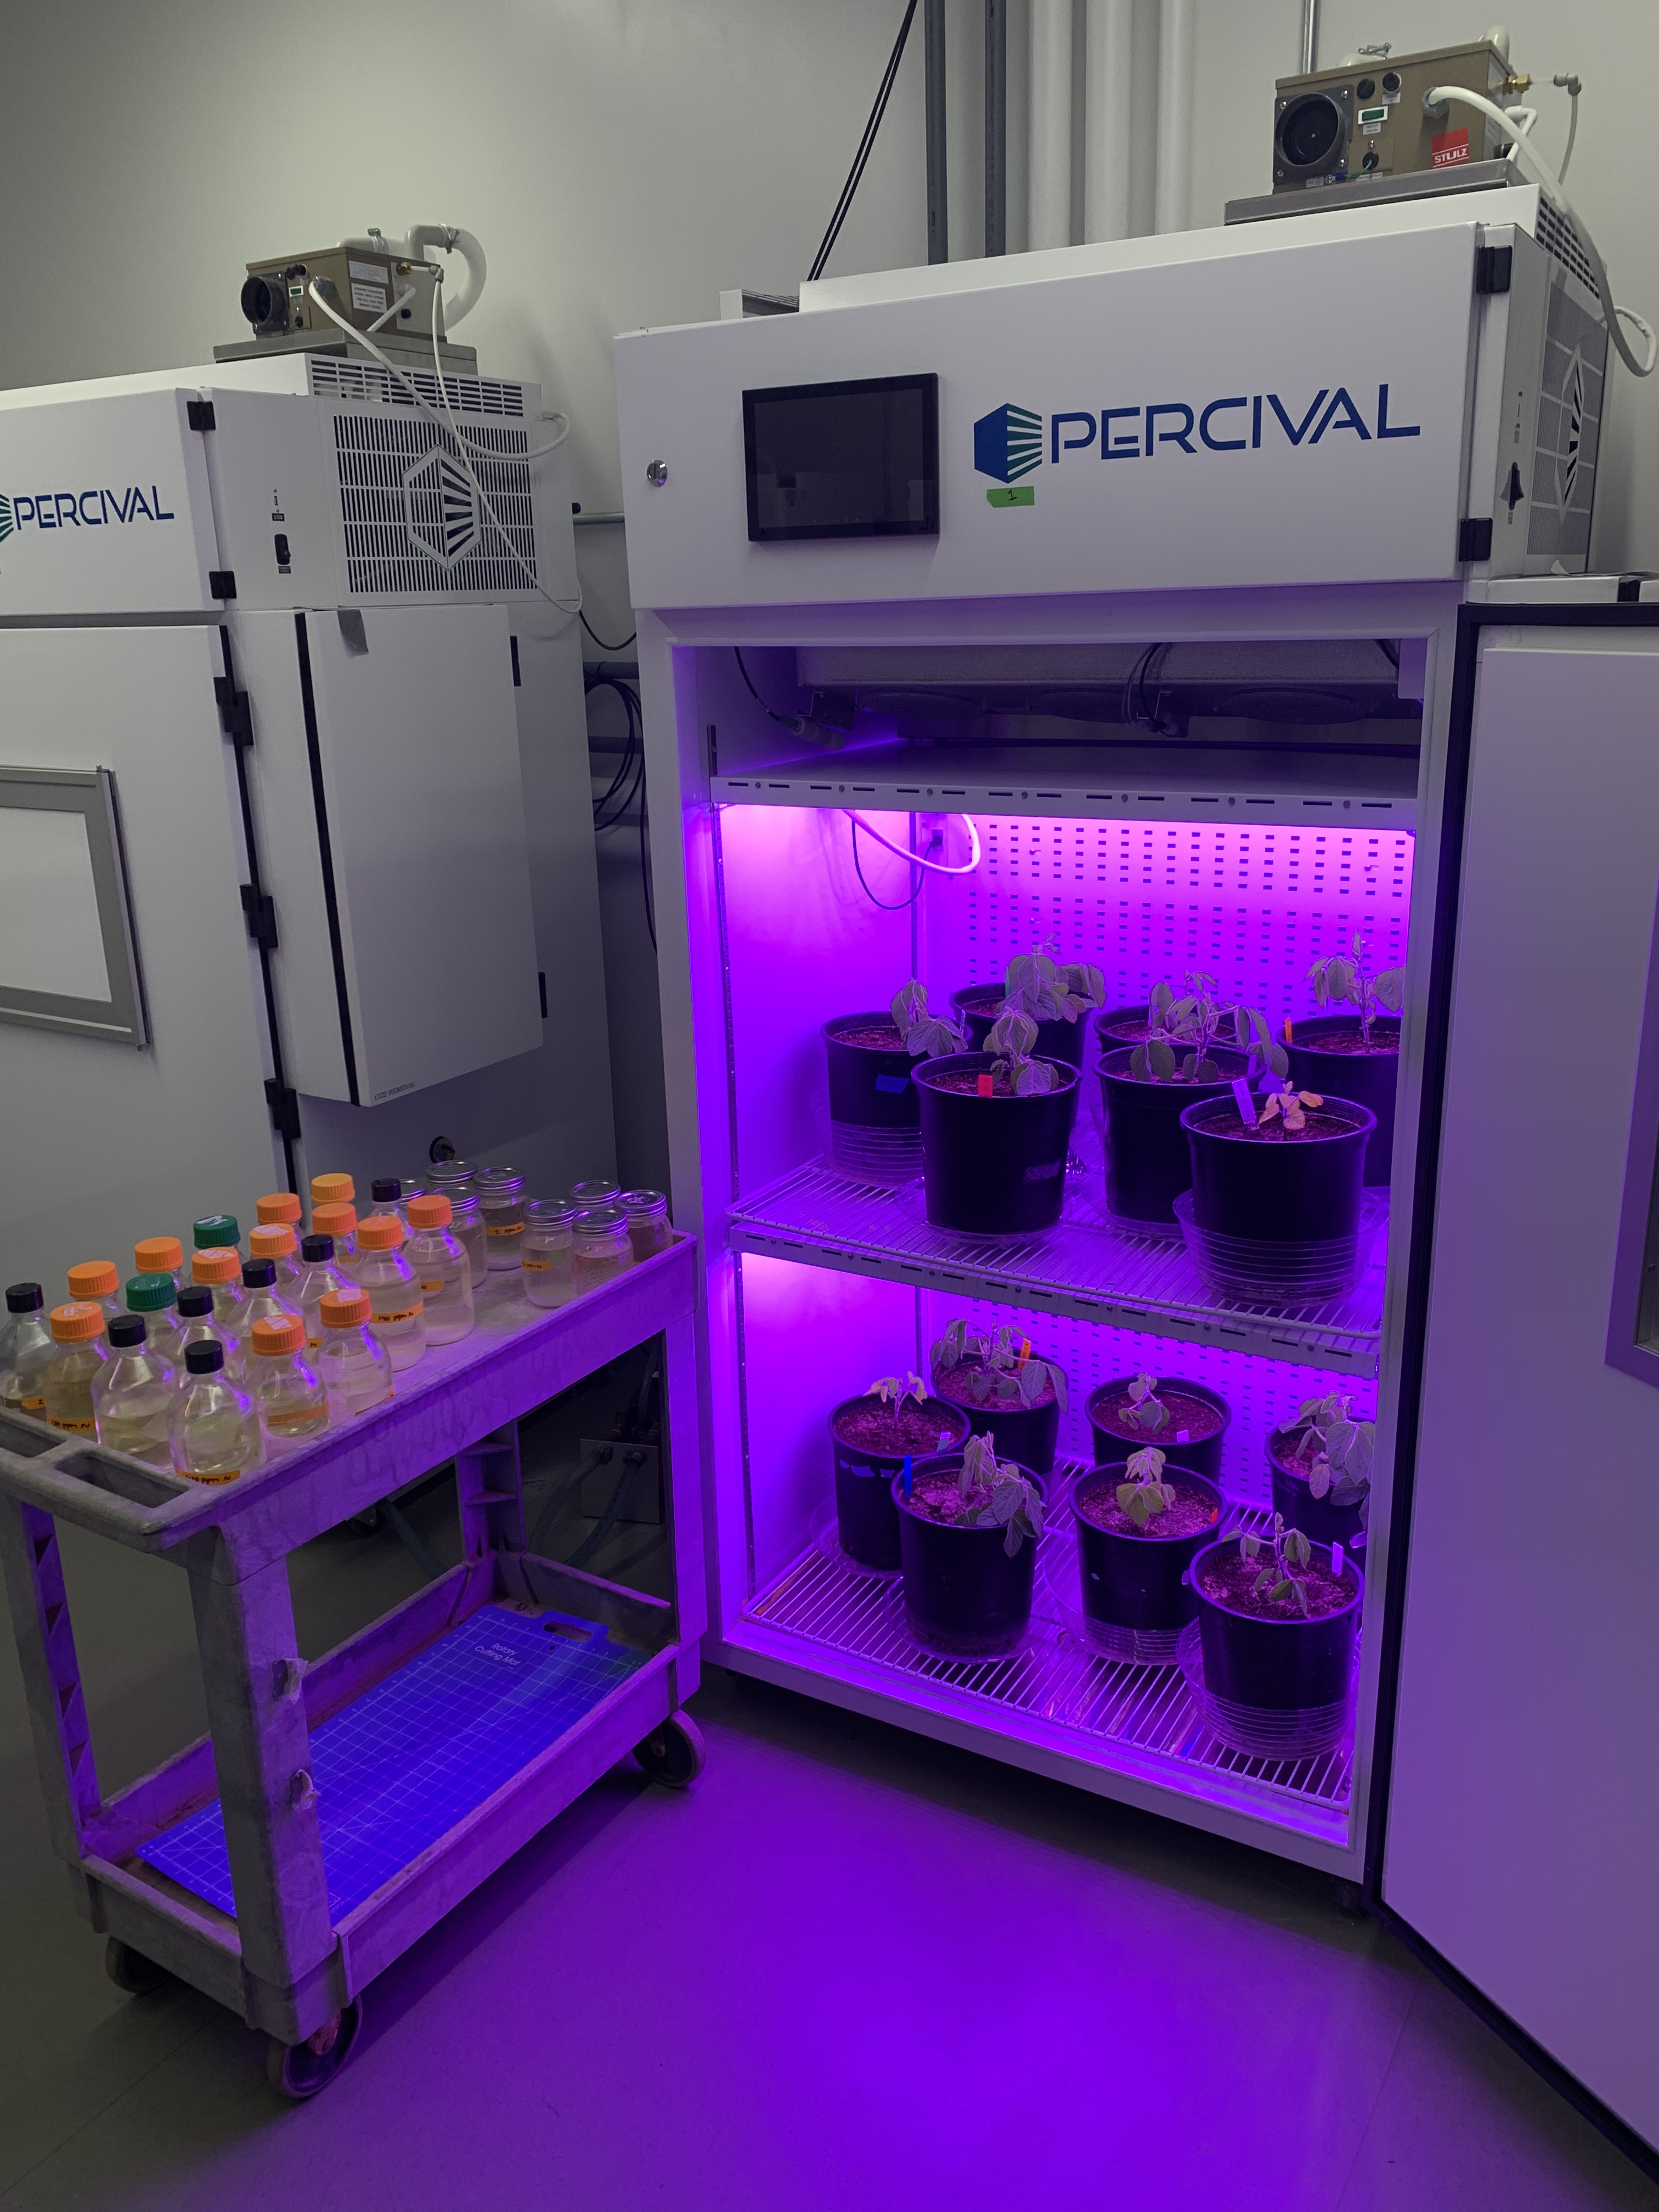
Optimal resource investment to photosynthetic capacity maximizes nutrient allocation to whole plant growth under elevated CO₂
Vignette 1
Vignette 2
Vignette 3
Perkowski et al. (in prep)

Slide 78
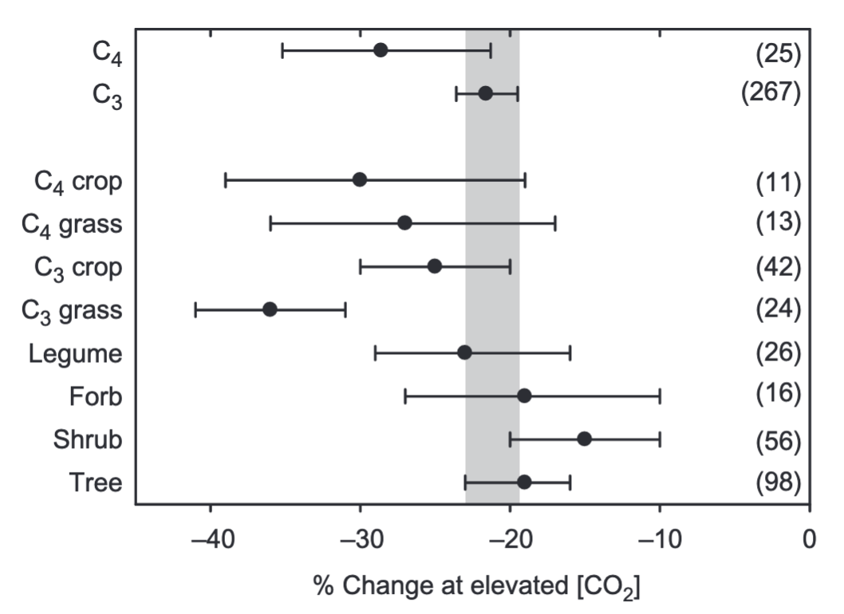
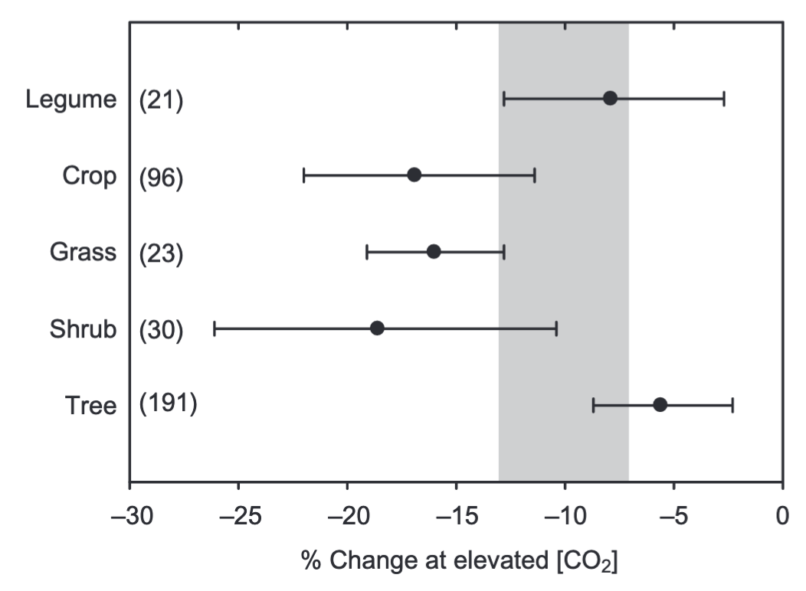
Increasing CO₂ decreases stomatal conductance and photosynthetic capacity…
Stomatal conductance
Photosynthetic capacity
Ainsworth & Rogers (2007) Plant, Cell & Environment
Notes:
We know that increasing CO2 generally has a negative impact on stomatal conductance, leaf nutrient allocation, and photosynthetic capacity.
This is a study from Ainsworth and Rogers showing the impacts of increasing CO2 on stomatal conductance in the left panel and photosynthetic capacity in the right panel
You can see that regardless of photosynthetic pathway or plant functional type that increasing CO2 generally decreases stomatal conductance and photosynthetic capacity

Slide 79
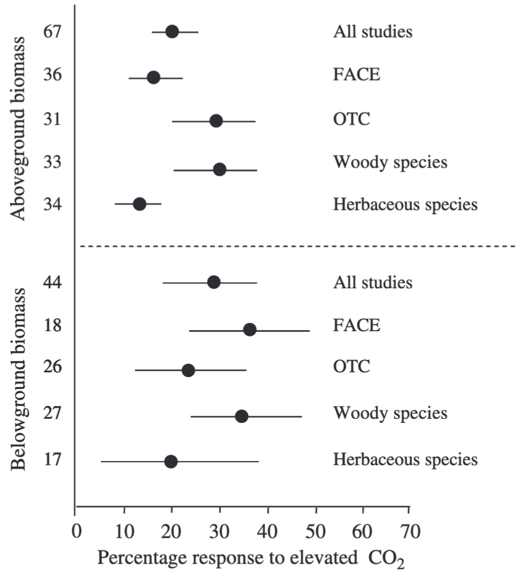
… which corresponds with stimulations in whole plant growth
Aboveground biomass
Belowground biomass
de Graaf et al. (2006) Global Change Biology
Notes:
Reductions in stomatal conductance and photosynthetic capacity often correspond with biomass stimulation over time, as indicated from these two plots from de Graaf et al. in (2006), where aboveground and belowground biomass generally increased with increasing CO2.
Given the fact that increasing CO2 stimulates growth, and that growth is commonly limited by nutrient availability, some have suggested that nutrient limitation could be the primary control of photosynthetic responses to increasing CO2.
Previous work points to a progressive nutrient limitation hypothesis, which predicts a reduction in belowground nutrient availability over time with increasing CO2 due to increased whole plant nutrient demand over time.
The progressive nutrient limitation hypothesis indicates an acute stimulation in whole plant growth with increasing CO2, but a gradual reduction in growth over time as nitrogen progressively becomes more limited

Slide 80
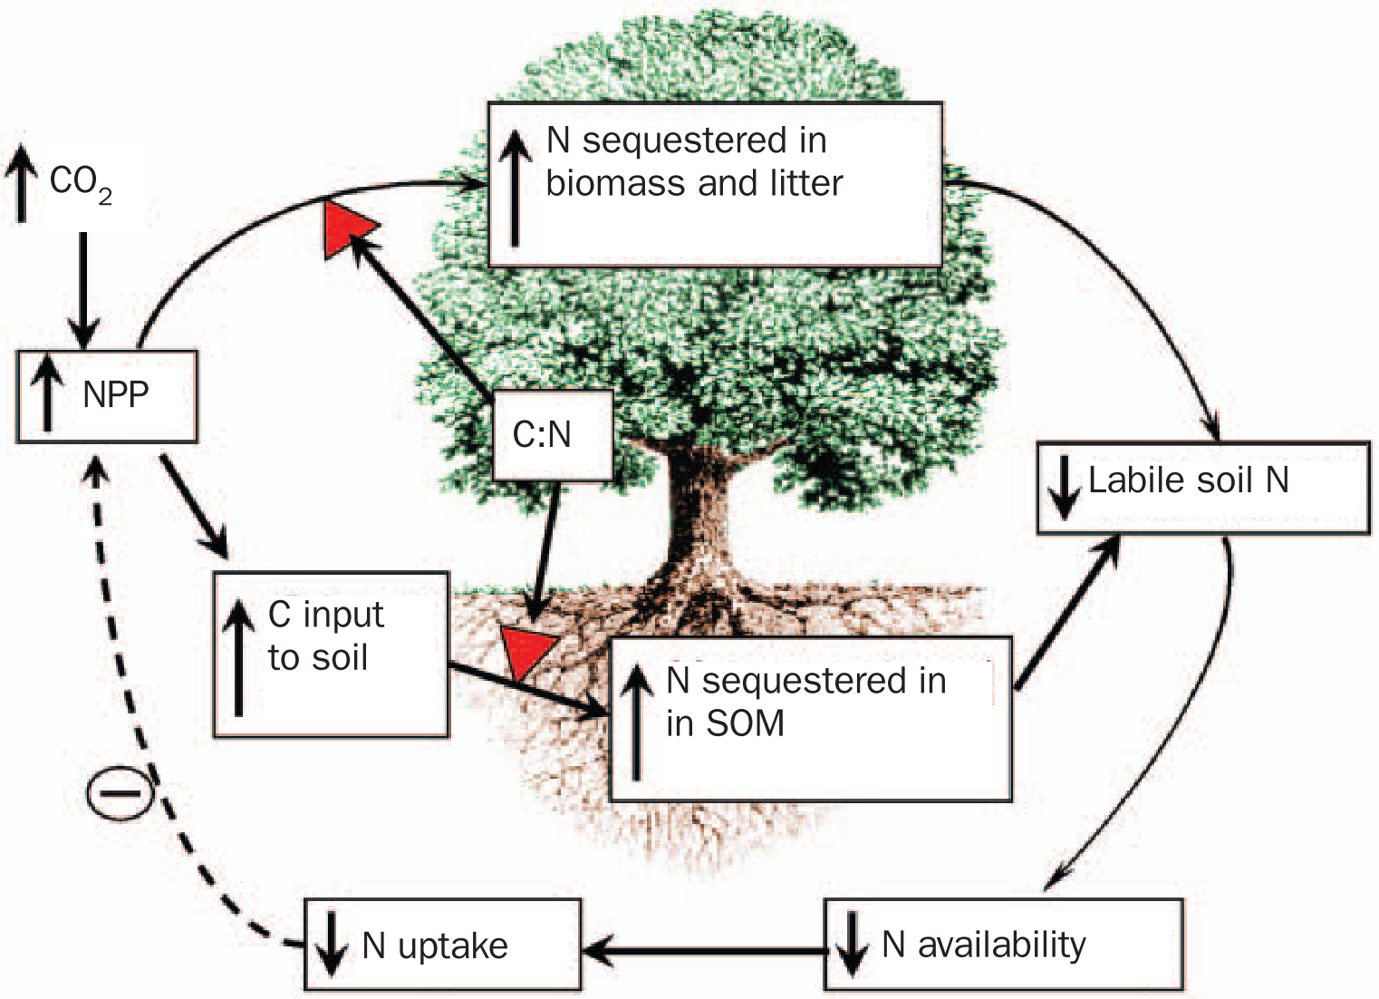
Progressive nutrient limitation has been hypothesized to be the primary mechanism driving these acclimation responses
Prerequisite for PNL: increased N allocation to longer lived tissues
Luo et al. (2004) BioScience

Slide 81
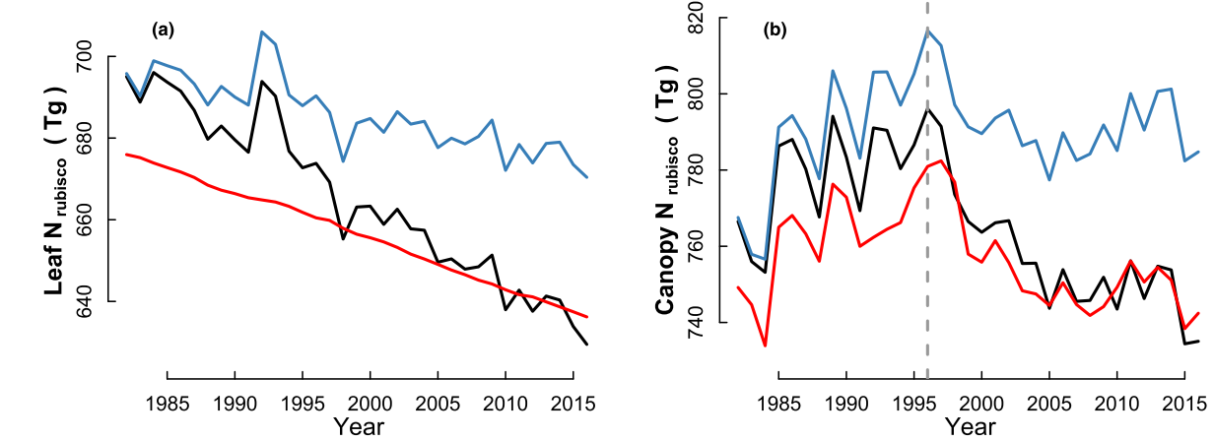
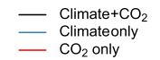
But, recent work indicates that elevated CO₂ may decrease leaf and whole plant nitrogen demand
Dong et al. (2022) New Phytologist
Notes:
A need to disentangle top-down and bottom-up controls on leaf and whole plant acclimation responses to elevated CO2

Slide 82
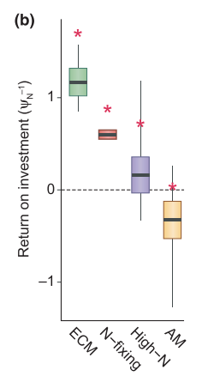
Leaf and whole plant acclimation responses to elevated CO₂ may depend on nitrogen acquisition strategy
Terrer et al. (2018) New Phytologist

Slide 83
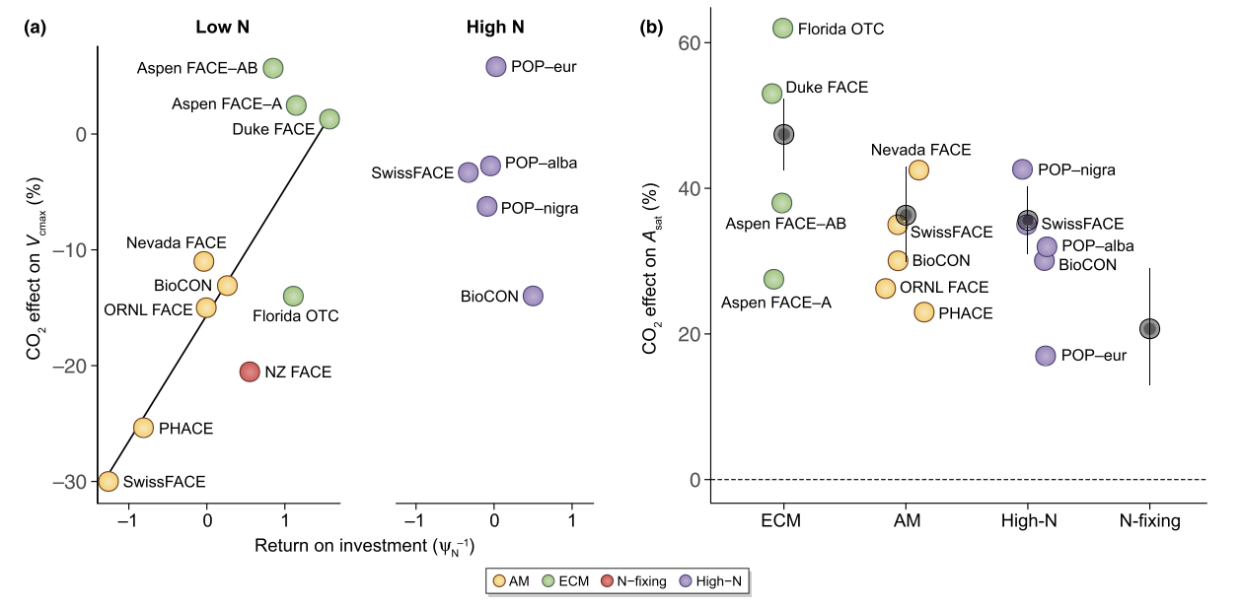
Leaf and whole plant acclimation responses to elevated CO₂ may depend on nitrogen acquisition strategy
Terrer et al. (2018) New Phytologist

Slide 84
Open questions
What is the role of soil nitrogen availability in modifying leaf and whole plant acclimation responses to CO₂?
What is the role of acquisition strategy in modifying leaf and whole plant acclimation responses to CO₂?

Slide 85
Experiment setup
Vignette 1
Vignette 2
Vignette 3
Acquisition strategy
Soil N treatments
0 ppm N
+ BNF
35 ppm N
- BNF
70 ppm N
105 ppm N
CO₂ treatments
140 ppm N
210 ppm N
+ BNF
280 ppm N
- BNF
350 ppm N
630 ppm N

Slide 86
Vignette 1: How do costs of nitrogen acquisition vary across environments?

Slide 87
Vignette 2: To what extent do edaphic and climatic factors modify nitrogen-water use tradeoffs?

Slide 88
Vignette 3: How does soil nitrogen availability modify plant acclimation responses to elevated CO₂?

Slide 89
Future Plans

Slide 90





Acknowledgements
Committee
CHAIR: NICK SMITH
AIMÉE CLASSEN

